Slide 1
Support for studying online

Slide 2
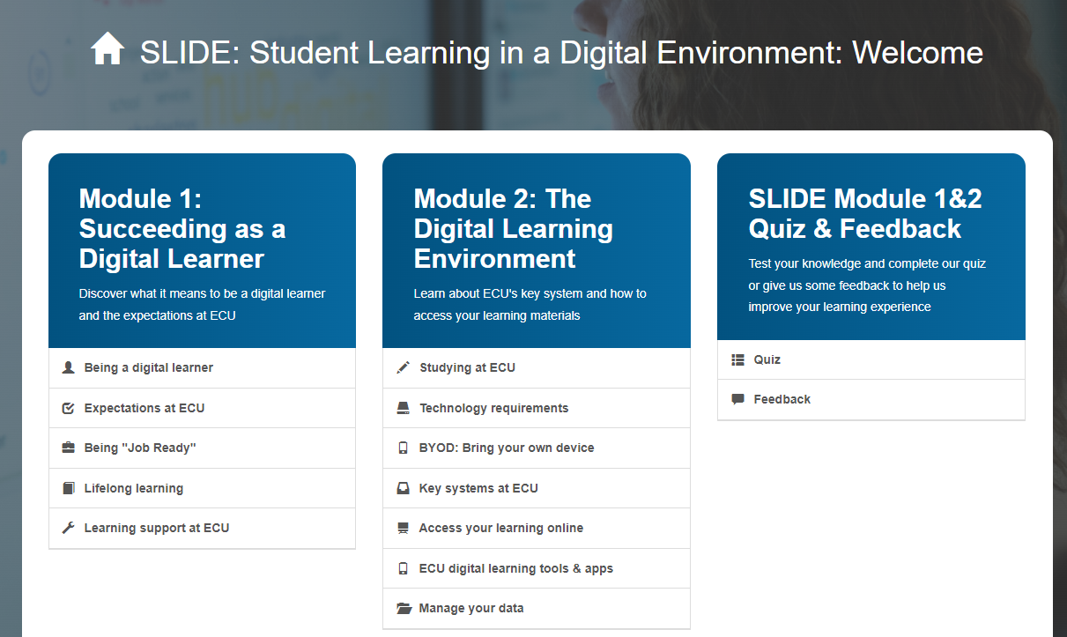

Online Essentials
Access the SLIDE modules which show how to communicate, collaborate and connect with your lecturers and fellow students
Use Microsoft Teams for online communication
Make the most of Learning Advisers who are here to help you with study skills and academic writing

Slide 3


Library and Learning Support
Ask a technology question by contacting Peer Assistants on campus or online
Contact library staff for help with finding online sources and referencing. Visit a drop-in or contact them online
Head into the Library and borrow a laptop for up to four weeks at a time
Access study support 24/7 online from Studiosity

