Slide 1


Submission Date Reminder!
Notes:
The aim of this set of slides is a quick 5 minute reminder on academic integrity one week prior to the assessment task submission date.

Slide 2


The FINAL Checks

Slide 3
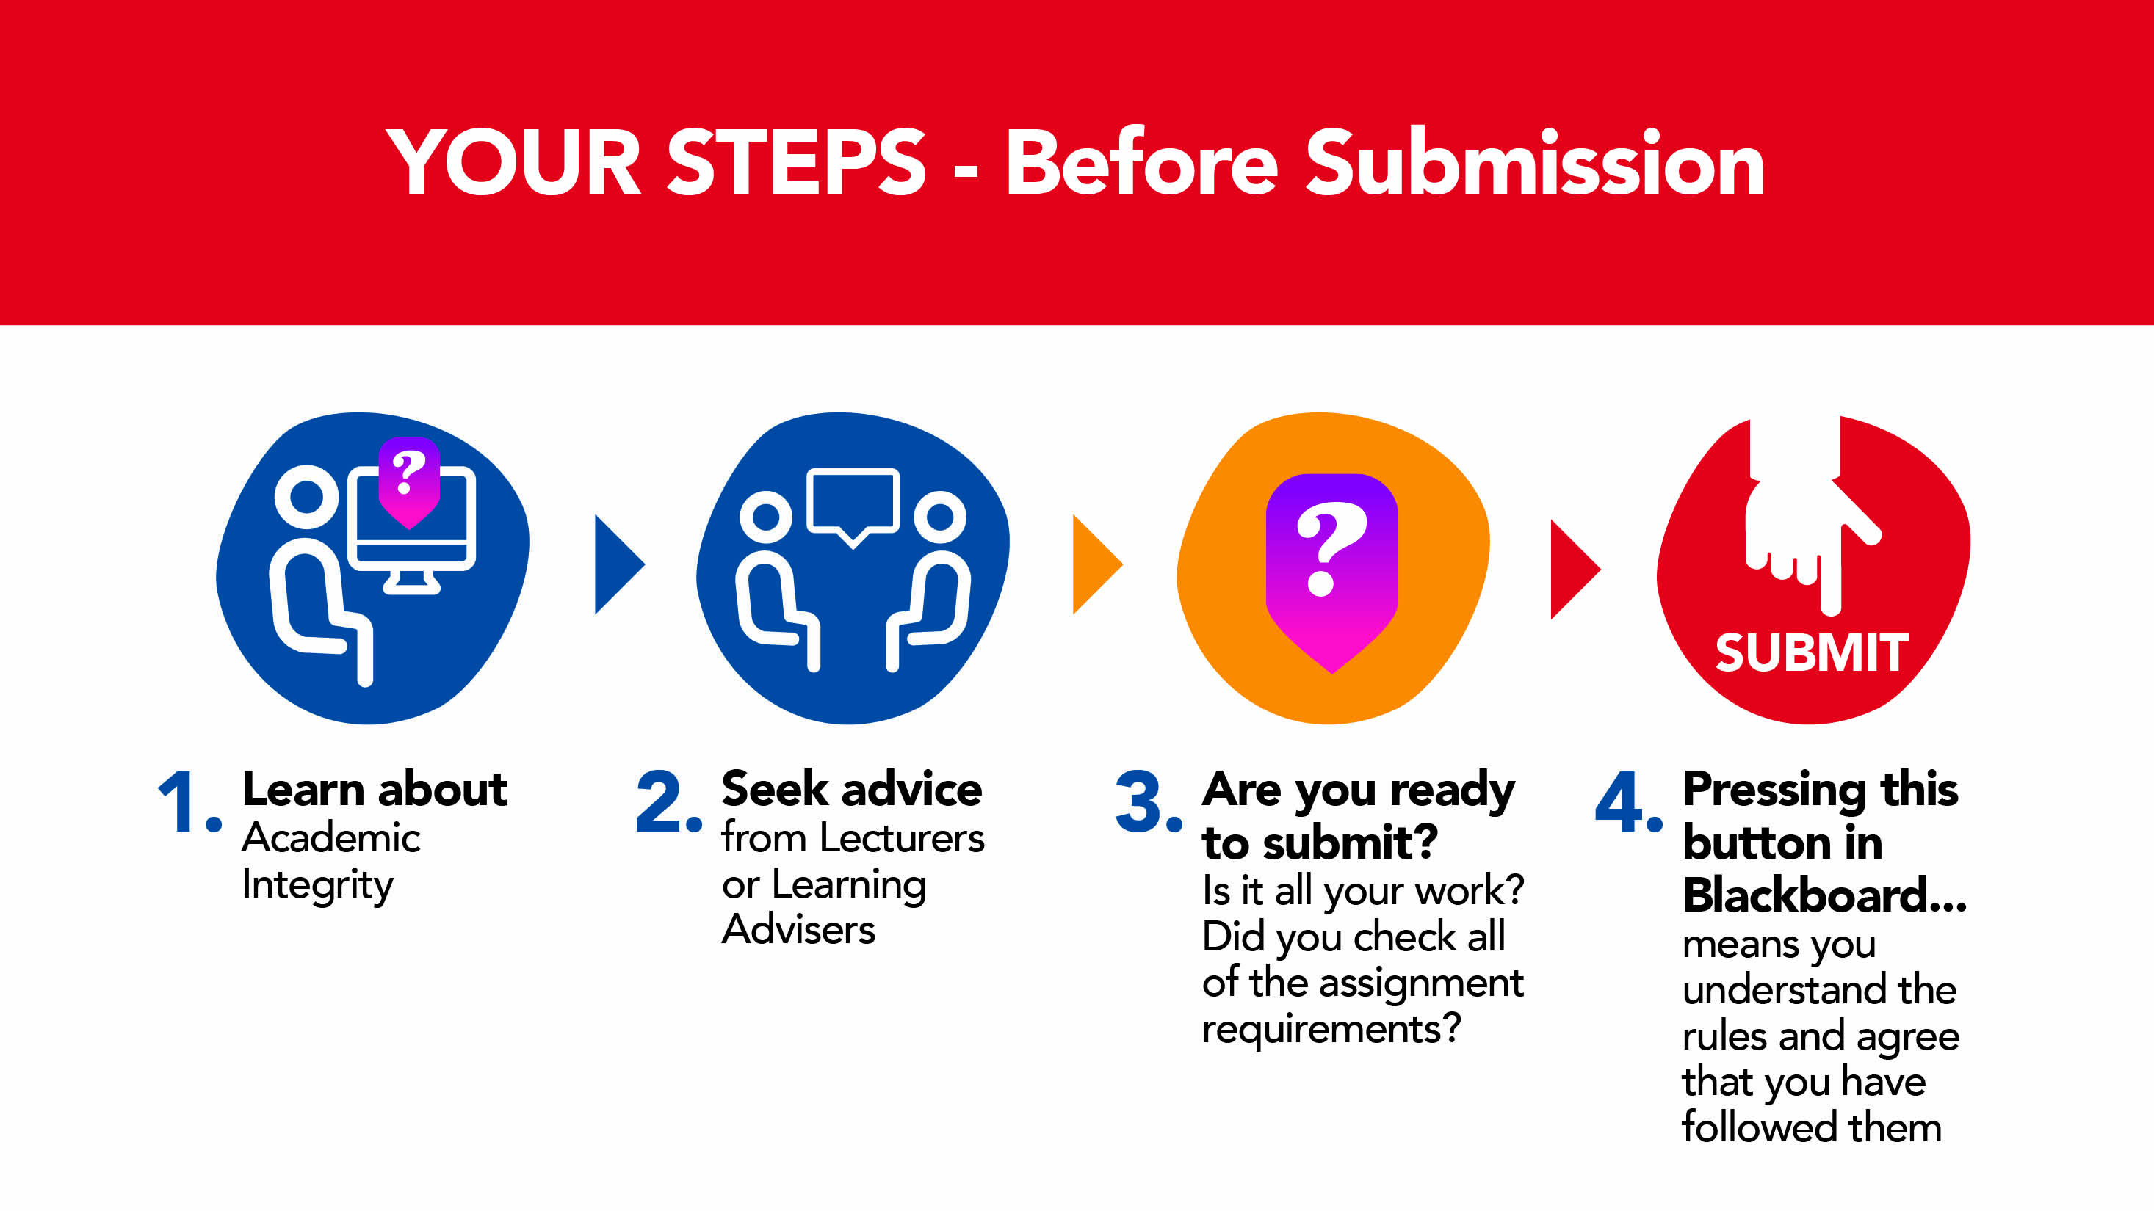
Steps to Submitting your work
Notes:
We Assume Students Know the Rules: it is assumed that all students, regardless of where they are from, how long since they last studied, or if they are in their first semester at university, have read the ECU rules in relation to Academic Integrity and Academic Misconduct. Subsequently ‘I do not know what academic integrity is, is not considered a reasonable excuse for breaches of Academic Integrity.
We Assume You Have Checked It: when undertaking an Academic Misconduct investigation, we assume that not only do students know the rules, but that they have thoroughly checked their own work against those rules prior to submitting their work.
Better Late Than Never: sometimes it can take a bit longer to thoroughly check your assignment in order to avoid breaches of Academic Integrity. It is better to submit your assignment a bit late and receive some late penalties rather than rush to submit by the deadline and end up involved in an Academic Misconduct investigation.

Slide 4
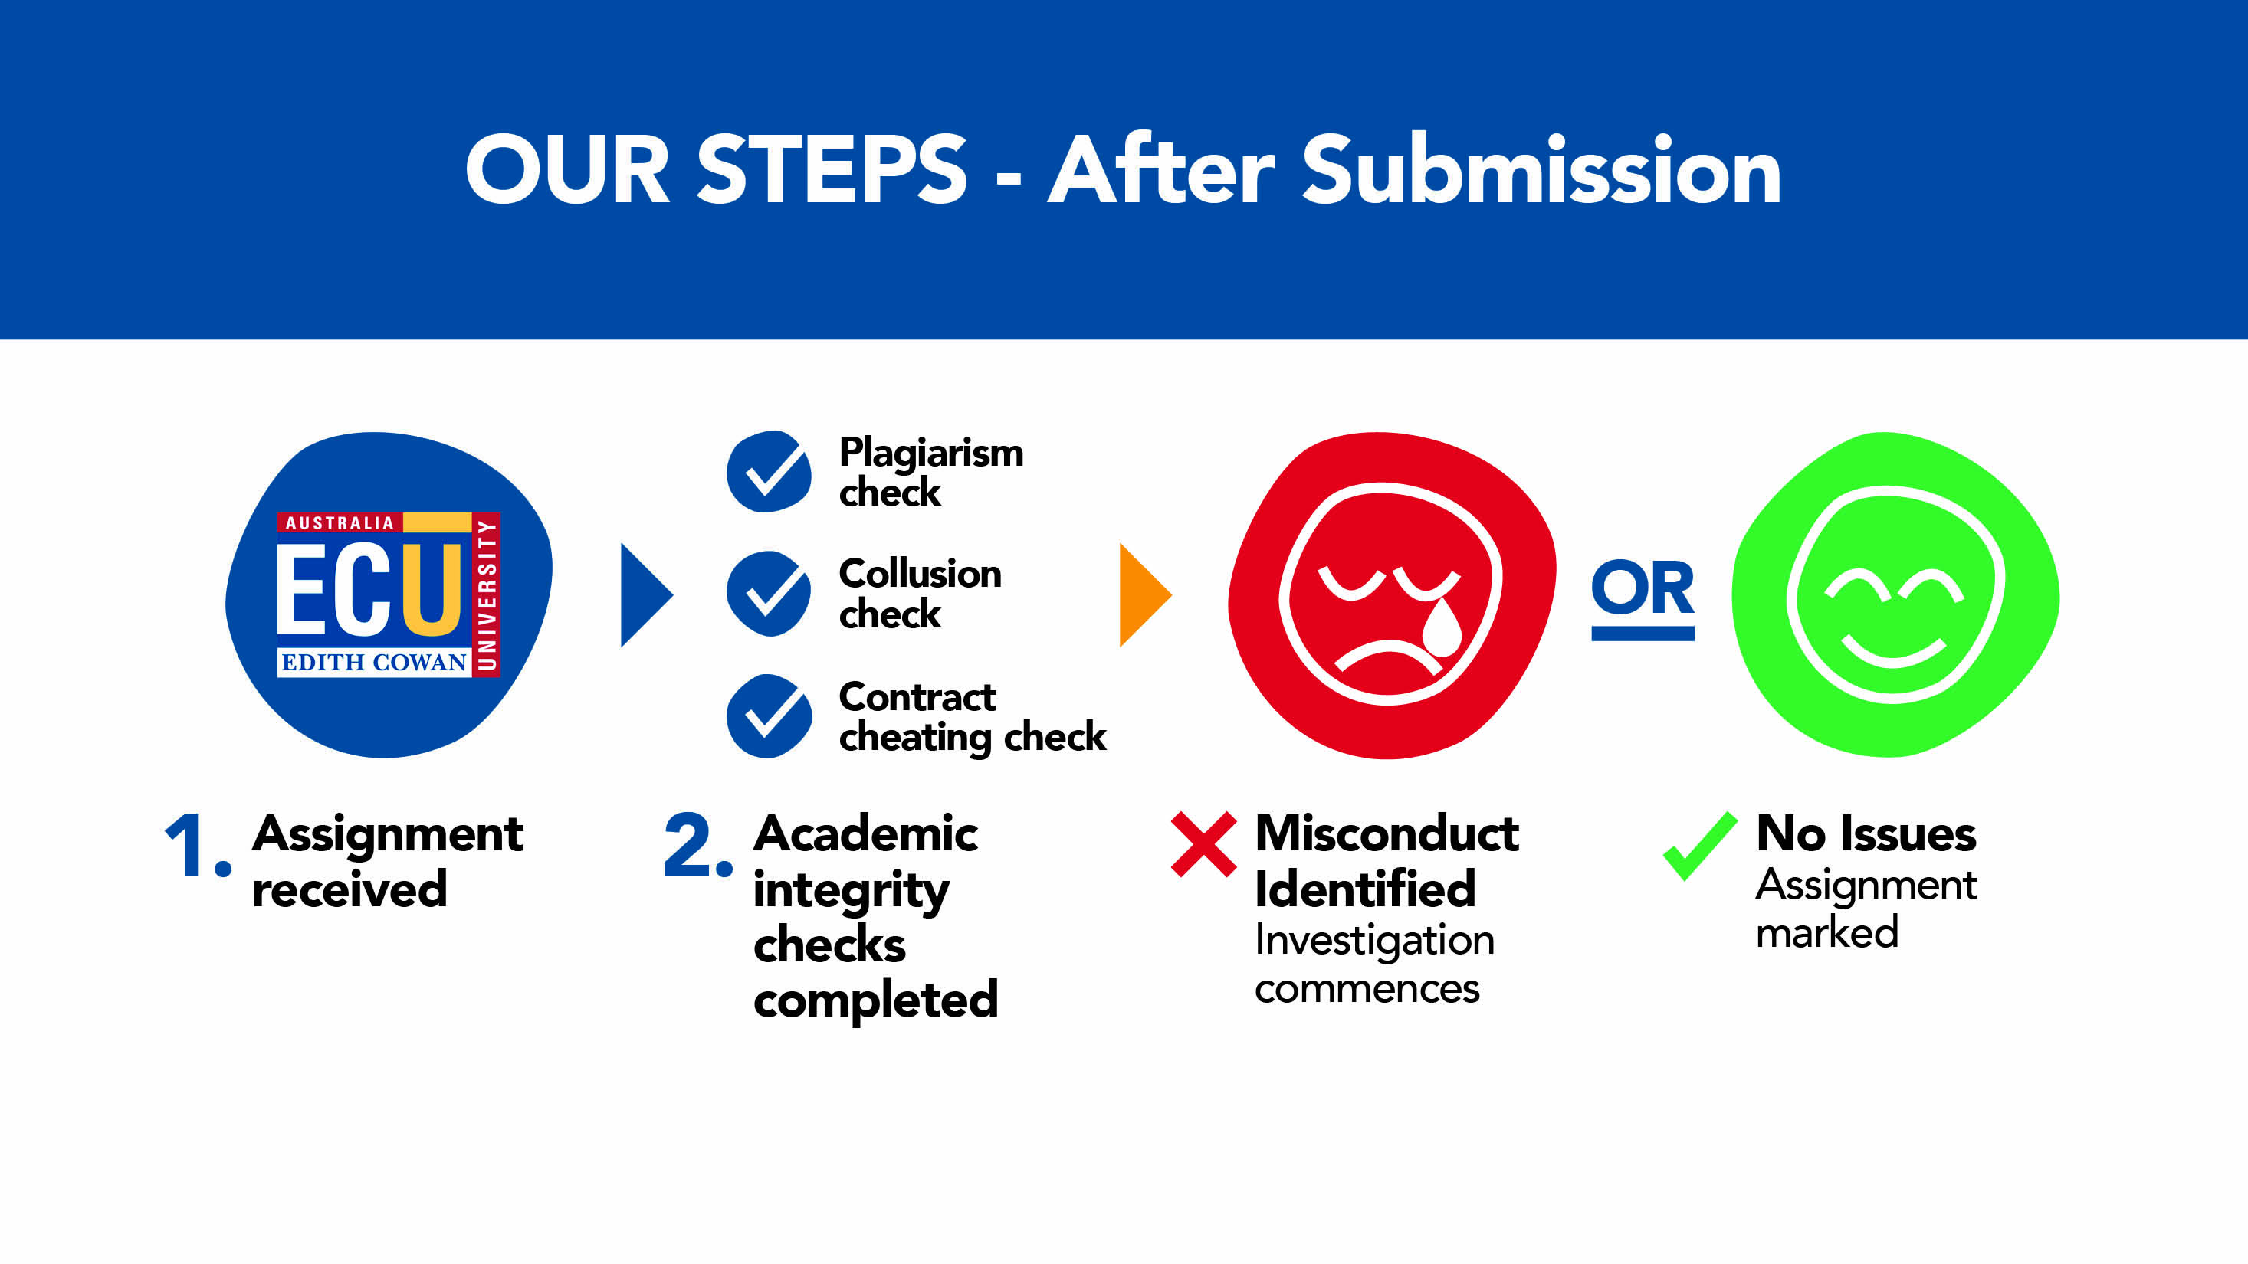
Steps Post-Submission

Slide 5

Why is Checking SO important?
We Assume Students Know the Rules: it is assumed that all students, regardless of where they are from, how long since they last studied, or if they are in their first semester at university, have read the ECU rules in relation to Academic Integrity and Academic Misconduct. Subsequently ‘I do not know what academic integrity is, is not considered a reasonable excuse for breaches of Academic Integrity.
We Assume You Have Checked It: when undertaking an Academic Misconduct investigation, we assume that not only do students know the rules, but that they have thoroughly checked their own work against those rules prior to submitting their work.
Better Late Than Never: sometimes it can take a bit longer to thoroughly check your assignment in order to avoid breaches of Academic Integrity. It is better to submit your assignment a bit late and receive some late penalties rather than rush to submit by the deadline and end up involved in an Academic Misconduct investigation.

Slide 6

Conclusion
Academic Misconduct does not happen by accident. It typically occurs as a result of poor planning and/or choices made early in the assignment process.
During Academic Misconduct investigations, students will often rationalise why they felt it necessary to take the steps that led them to a misconduct investigation, and while the investigator may sympathise, such rationalisations have no impact on the final misconduct finding.
The best and only way to avoid the stress and marks impact of breaching Academic Integrity rules is simply not to do it in the first place.
Remember, check your work, ask your lecturer or tutor, speak to a learning adviser, but only before you submit your work, not after.

Slide 7
Resources (examples only insert relevant to your Unit)
Academic Skills Workshops
Attend an Academic Skills Workshop on a whole range of topics such as essay writing, report writing, referencing, etc. The schedule is available from the Academic Skills Centre Blackboard site under ‘My Communities’.
Assignment drop-in sessions
Attend a Assignment drop-in session <insert dates and time relevant to your unit> where you can get help with academic literacy and numeracy skills.
Subject guides
Please visit our, insert your specific discipline guides> subject library guides where you will find links to databases and other resources directly related to your subject, such as <insert her the relevant subject areas and more.
Referencing
For an introduction to APA Style (6th ed.) referencing and a selection of common sample references, check out the ECU Library Guide on Referencing https://ecu.au.libguides.com/referencing
AIM module
Complete the Academic Integrity Module – information and practical activities on how to develop your academic writing skills. [If you are not enrolled in this Module through your Unit contact academicintegrity@ecu.edu.au who will arrange to provide access to complete it.]
PASS
Peer Assisted Study Sessions are available for <insert if your unit is included in this program>. This program is where your peers assist you develop effective study skills.

Slide 8
References
Busch, P., & Bilgin, A. (2014). Student and staff understanding and reaction: Academic
integrity in an Australian university. Journal of Academic Ethics 12(3), 227-243.
doi:10.1007/s10805-014-9214-2
Edith Cowan University, Strategic and Governance Services. (2019a). Academic integrity policy. Retrieved from http://policysearch.ecu.edu.au/WebDrawer.PolicySearch/Record/725/file/document
Edith Cowan University. (2019b). Academic misconduct rules (students). Retrieved from http://policysearch.ecu.edu.au/WebDrawer.PolicySearch/Record/174/file/document
Fishman, T. (Ed.) (2014). The fundamental values of academic integrity. Retrieved from https://academicintegrity.org/wp-content/uploads/2017/12/Fundamental-Values- 2014.pdfttps://academicintegrity.org/wp-content/uploads/2017/12/Fundamental-Values-2014.pdf
University of Sussex. 2016. Academic integrity and avoiding plagiarism. Retrieved from http://www.sussex.ac.uk/skillshub/?id=287&site=normal
Adapted from a School of Science teaching resource with the kind permission of Justin Brown (ADTL, School of Science) and Tina Fleming (Senior Learning Adviser, School of Science), August 2019.

