Slide 1


A Reminder!
Notes:
The aim of these slides is to provide you with some guidance/hints n tips to remind Experienced students (i.e. in a non-foundational unit) about academic integrity in the first few weeks of semester.
There is another set of slides that can be as a reminder of good academic practice nearing an assessment task submission date.

Slide 2

What is academic integrity?
What do you understand by academic integrity?
Trust
Responsibility
Fairness
Honesty
Courage
Respect
(Fishman, 2014, p.14)
Notes:
Discussion Points:
Ask students to think about and discuss in pairs what they think academic integrity means
Academic Integrity and a students responsibilities – see https://intranet.ecu.edu.au/student/my-studies/academic-integrity/what-is-academic-integrity
Academic Integrity & Your Responsibilities
The International Centre for Academic Integrity defines academic integrity as "a commitment to five fundamental values: honesty, trust, fairness, respect, and responsibility", and “the courage to act on them even in the face of adversity" (Fishman, 2014, p.16). At ECU this is driven by our values of Integrity, Respect, Rational Inquiry and Personal Excellence.

Slide 3

Why academic integrity is important to YOU and ECU?
Acting with academic integrity means that:
Others can trust you and can rely on your honesty.
You will do what you say you
will do and do the right thing.
Your future employability is heavily reliant on your ability to demonstrate integrity and honesty.
It is a whole of university approach - Everyone has a role to play!
(University of Sussex, 2016)
Notes:
Establishing expectations of good academic practice
Discussion – what do the students think it looks like?

Slide 4
Acting with academic integrity
You are engaged in your learning.
You Undertake your studies diligently and with the aim of genuinely achieving the learning outcomes of the Unit.
You are engaged in assessment tasks and submitting work that has been correctly in-text and end-text referenced.
You are honest about your own work - that the work you submit for Assessment is YOUR work, or if a group assessment task, the GROUP's work.
You consider the opinions and values of others, such as in group discussions or group assessment tasks.
You demonstrate the highest personal and professional standards
So Be organised, Know your Skills Set, Set yourself Manageable Timelines, Keep track of your Research and Seek out Support
Source: student academic integrity website: https://intranet.ecu.edu.au/student/my-studies/academic-integrity/acting-with-academic-integrity
Notes:
See https://intranet.ecu.edu.au/student/my-studies/academic-integrity/acting-with-academic-integrity for more information

Slide 5
So what is academic misconduct?
If a student uses other people’s work without due recognition of the author(s), works too closely together with other students on individual assessments or have other people complete their work for them (paid or unpaid) then this is academic misconduct.
Any conduct by a Student in relation to academic work that is dishonest or unfair, constitutes academic misconduct and includes:
a) Bribery or Coercion;
b) Cheating in Examinations;
c) Contract Cheating;
d) Fabrication and/or Falsification;
e) Failure to meet required research standards;
f) Plagiarism; and
g) Unauthorised Collaboration
as defined in the ECU University Rules: Academic Misconduct Rules (Students).
(Edith Cowan University, Strategic and Governance Services, 2019b)
Notes:
So what happens if you do not act with Academic Integrity
Academic Misconduct results in serious outcomes, including being asked to leave the university. Acts of academic misconduct DO NOT align to the Values of ECU, and are seen as unacceptable behaviours and may result in you being suspended or expelled.
Show them the ECU Academic Misconduct Rules (Students) document and where to find it: https://intranet.ecu.edu.au/student/my-studies/academic-integrity
Introduce them to the resources available on the student academic integrity website

Slide 6

Be AWARE!
It can sometimes be accidental but it can also be deliberate. Whether it’s intentional or unintentional it’s still misconduct, will be investigated and can lead to significant consequences.
Responsibility
It’s your responsibility to be aware of the requirements of proper academic conduct and to demonstrate good academic practice and ethical scholarship.
Let’s look at the most common forms of
academic misconduct…….

Slide 7

Plagiarism
Notes:
Do Not Copy and Paste: copying and pasting is the most common cause of students becoming involved in Academic Misconduct investigations. External sources should support your arguments and ideas.
Paraphrase/Summarise or Quote: write the idea/text in your own words and style (usually preferred) or you can “quote” them providing author, year and page number(s) from which the original text is taken..
Acknowledge Your Sources by Referencing: for each paraphrase or direct quote you must include an in-text reference with a corresponding end-text reference – the Reference List.
Check Your Work: run your assignment through Turnitin before you submit it, identify any required improvements. Make sure you leave enough time to do this before the submission date.
Do Not Re-Use Work: self-plagiarism is not allowed. If you wish to re-use your own work in another assignment or if you are repeating a unit, you can only do so if the unit coordinator gives you written permission prior to submission.

Slide 8
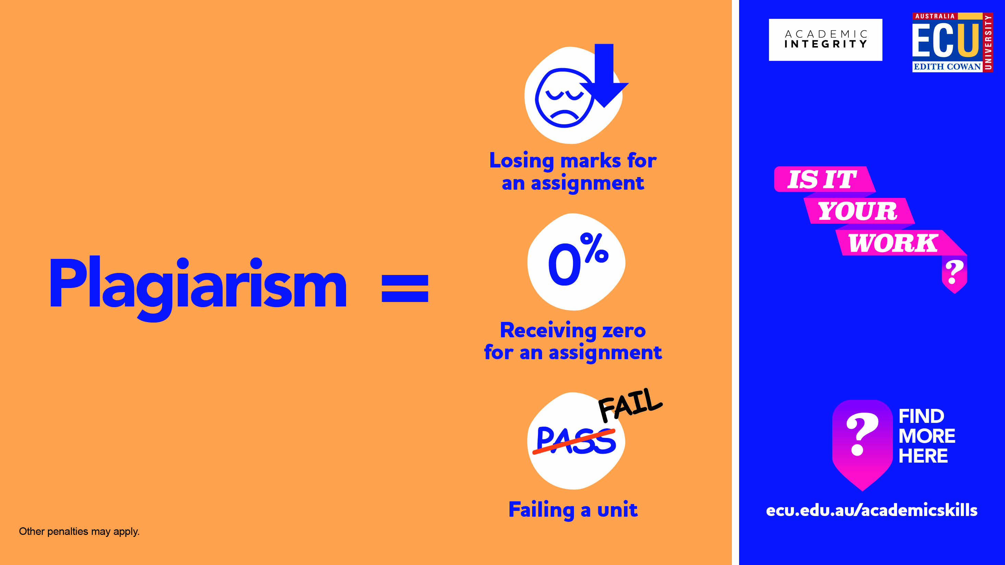
Plagiarism
The Student Academic Integrity Website has more information on how to avoid Plagiarism: https://intranet.ecu.edu.au/student/my-studies/academic-integrity/avoiding-academic-misconduct
Notes:
Referencing if you don’t know how to correctly reference your work check out the the ECU Referencing Library Guide: https://ecu.au.libguides.com/referencing
For help on how to in-text reference as part of your academic writing
Check out the Academic Skills Centre workshops both on campus and online
https://intranet.ecu.edu.au/student/my-studies/study-assistance/academic-skills-centre

Slide 9
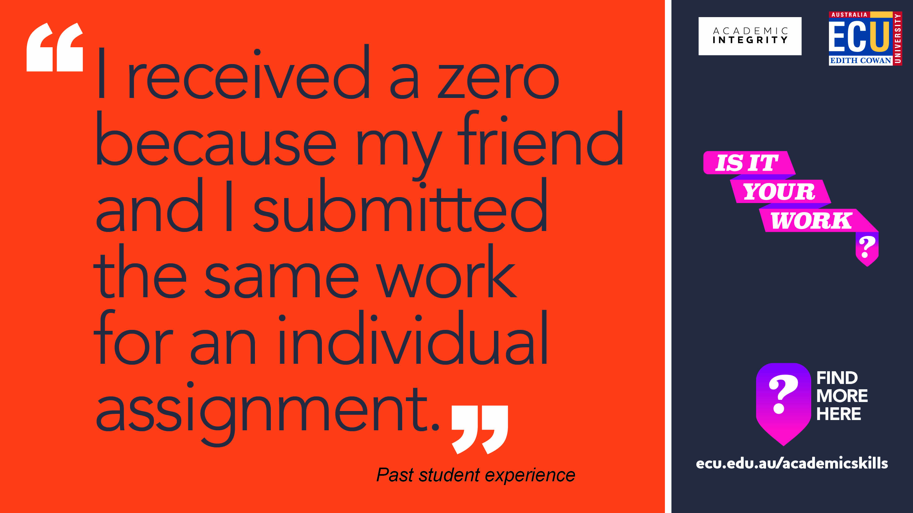
Unauthorised Collaboration
Notes:
Do Not Share Your Work: it is ok for students to problem solve or offer each other advice, but never share your work with other students. Approximately half of collusion cases arise from one student giving their assignment work to a peer as a ‘guide’ to approaching the assignment, after which the recipient immediately submits the assignment as their own. This results in both students in an Academic Misconduct investigation.
Do Not Work Side by Side: sometimes two or more students will work as an unofficial team on an assignment problem which leads to these students submitting work that is very similar or identical. This results in these students being part of an Academic Misconduct investigation.
Note: Meeting with peers to discuss aspects of your learning, sharing ideas or even relevant articles for your assessment is part of your learning and being immersed in an academic community. It is not collusion if you then build from these discussions your own thoughts, ideas or arguments, and are trusted by your peers to present YOUR work for assessment. Remember your responsibilities as part of ECU and the wider global academic community. Also remember that your lecturers will rarely, if ever, set an assignment where they expect to see identical work submitted as part of an individual assessment.

Slide 10
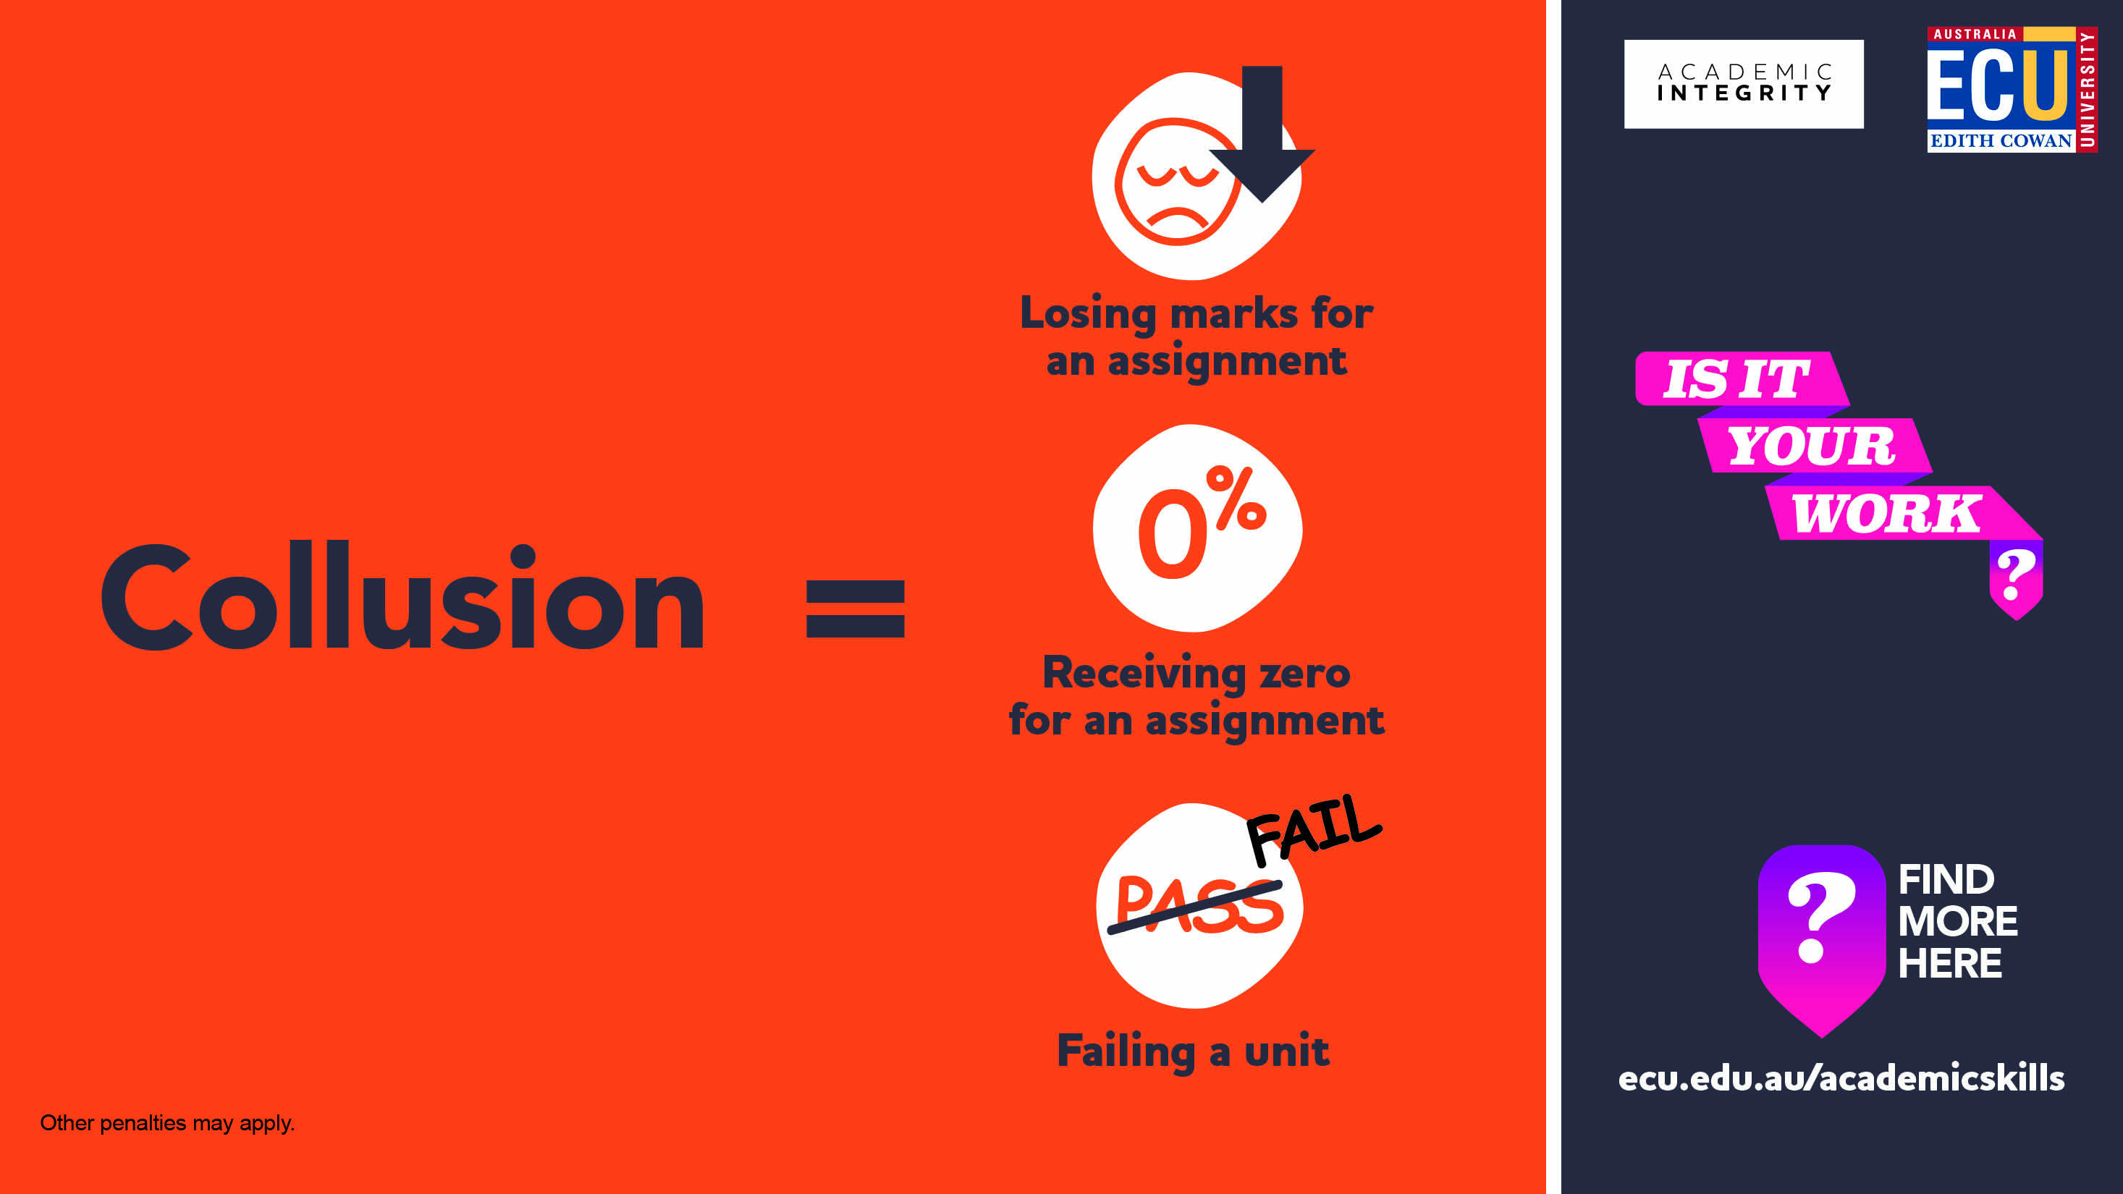
Unauthorised Collaboration
Notes:
The consequences of working collaboratively when an individual assignment is required.

Slide 11
Some scenarios to discuss
Scenario One:
A student is struggling with an assignment and contacts the Academic Skills Centre to seek the help of a Learning Adviser. They explain how to improve the draft assignment or better meet the assignment requirements.
Scenario Two:
Five students are working on their group assignment. They divide the assignment into five equal parts and each complete one. One student collates the work and submits it on behalf of the group
Scenario Three:
Three students e-mail their assignment drafts to one another. They all then revise their own drafts to include ideas they hadn’t previously considered, taking care not to copy each other’s ideas word for word.
Notes:
Scenario One – additional question: What happens if the student asked a parent instead? Or perhaps another student in the course?
Scenario Two – additional question: Is this collaboration? What if the task instructions required all students to contribute to each part?
Scenario Three – additional question: Would it be different is some ideas had been copied word for word?
For more scenarios see the Collaborating with Integrity Tipsheet: https://cheatingandassessment.edu.au/wp-content/uploads/2018/09/STUDENT-RESOURCE-Collaborating-with-integrity.pdf

Slide 12
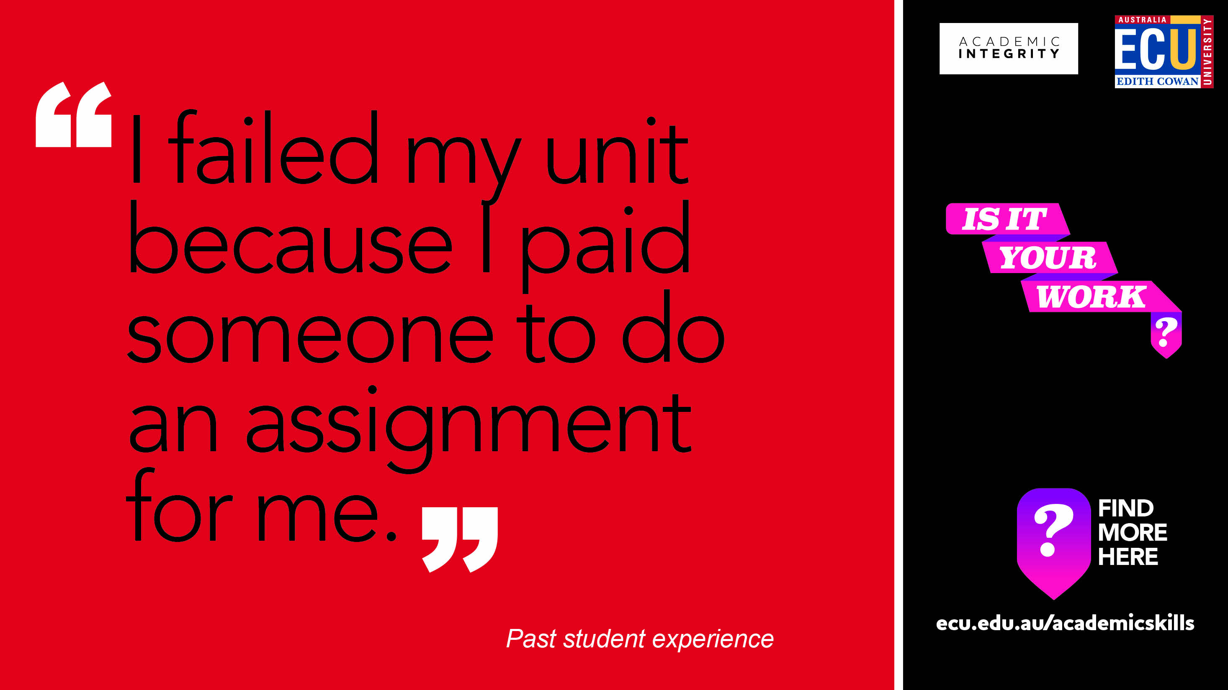
Contract Cheating
Notes:
Do Not Seek External Assistance: your lecturers and tutors are paid to assist and advise, but they do not provide answers. If you seek assistance from friends, prior students or external ‘tutors’ and they provide you with content or do some or all of the work for you then this is considered very serious Academic Misconduct. Actual contract cheating is quite easy to spot by our academic staff and is easily proven during subsequent Academic Misconduct investigations.
A Slippery Slope: contract cheating can start quite innocently by using paid ‘tutoring’ services, but in the end, if the ‘help’ you receive means you still cannot do the assessment work yourself (write it, code it, calculate it, analyse it) and you submit that work, it is contract cheating. Remember, these tutoring services could not care less if you are expelled from university as they have already been paid.

Slide 13
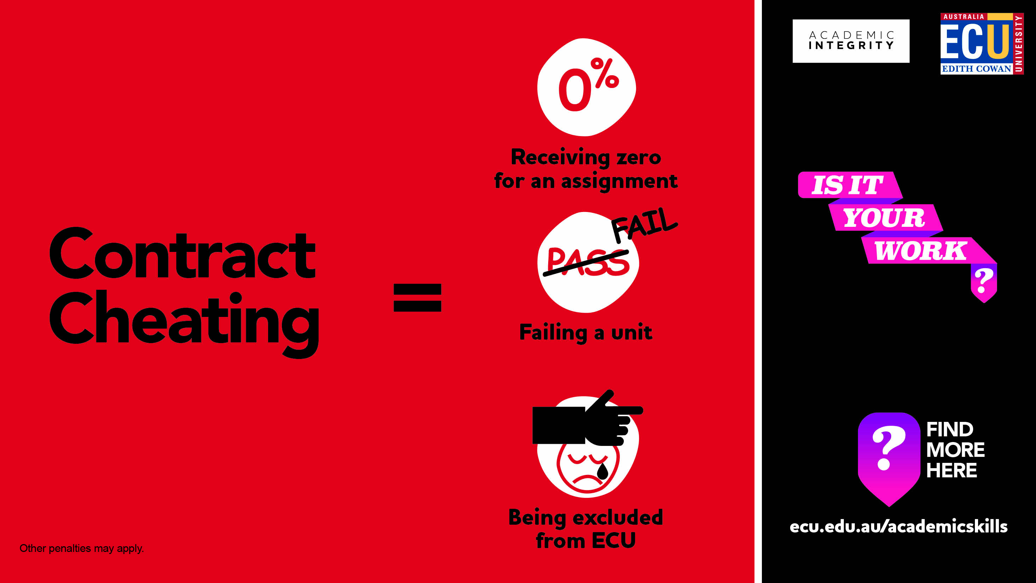

Contract Cheating
Remember the Learning Advisers are also there to help and support you.
Notes:
Students who outsource their assignments will be caught as while technology can help them get someone else to do their assignment , technology also helps me (tutor) identify them.
These unscrupulous essay mills have also been know to blackmail students who have used their services (extortion etc.) – if you do find yourself in this position then please ask for help.

Slide 14
Let’s look a these scenarios
Scenario One:
Eight students gather in the Library to complete an online quiz together which is worth 10% of their grade. They share all their answers and only get one wrong.
Scenario Two:
A student shares their assignment from a previous semester with a friend now enrolled in the same course. The student is sure that her friend will not plagiarise it, but only use it as a guide.
Scenario Three:
A student is working on a large assignment and pays a professional assignment writer to complete parts of it for him. He knows that businesses regularly outsource work, so as long as he pays a fair price, he believes the work belongs to him and he can submit it as his own.
Notes:
Scenario One – additional question: Would it be different if the quiz was worth more? Do you think we (the tutors) expect you (students) to do these tasks together?
Scenario Two – additional question: What if her friend does plagiarise it, or submits it as her own? What if the student uploaded it to a file -sharing site so lots of students could use it?
Scenario Three – additional question: Does the work belong to him? Would it be worse if he had outsourced the whole assignment? What if he hadn’t paid money for it?
For more scenarios see the Collaborating with Integrity Tipsheet: https://cheatingandassessment.edu.au/wp-content/uploads/2018/09/STUDENT-RESOURCE-Collaborating-with-integrity.pdf

Slide 15
Unit specifics can be added here
When you add a new slide to this PowerPoint, you can choose from a number of layouts that have been set up within the Slide Master.
To do this, follow these steps:
Select the “Home” tab at the top of your screen.
Select the drop-down arrow next to “New Slide” (near top left corner) – here you can preview and select a template layout to suit your needs.
Note: you can also change the layout of an existing slide by navigating to the desired slide, selecting “Layout” (near top left corner) and choosing a different layout.
When creating PowerPoints, only the ECU corporate colours should be used. These have been setup within the template (e.g.. you will see them when you go to change the font colour).
Note: there should be no need for you to edit the Slide Master however if you do, please keep in mind that any changes you make to master slides will affect all slides within your PowerPoint that use that particular layout.

Slide 16

The FINAL Checks

Slide 17
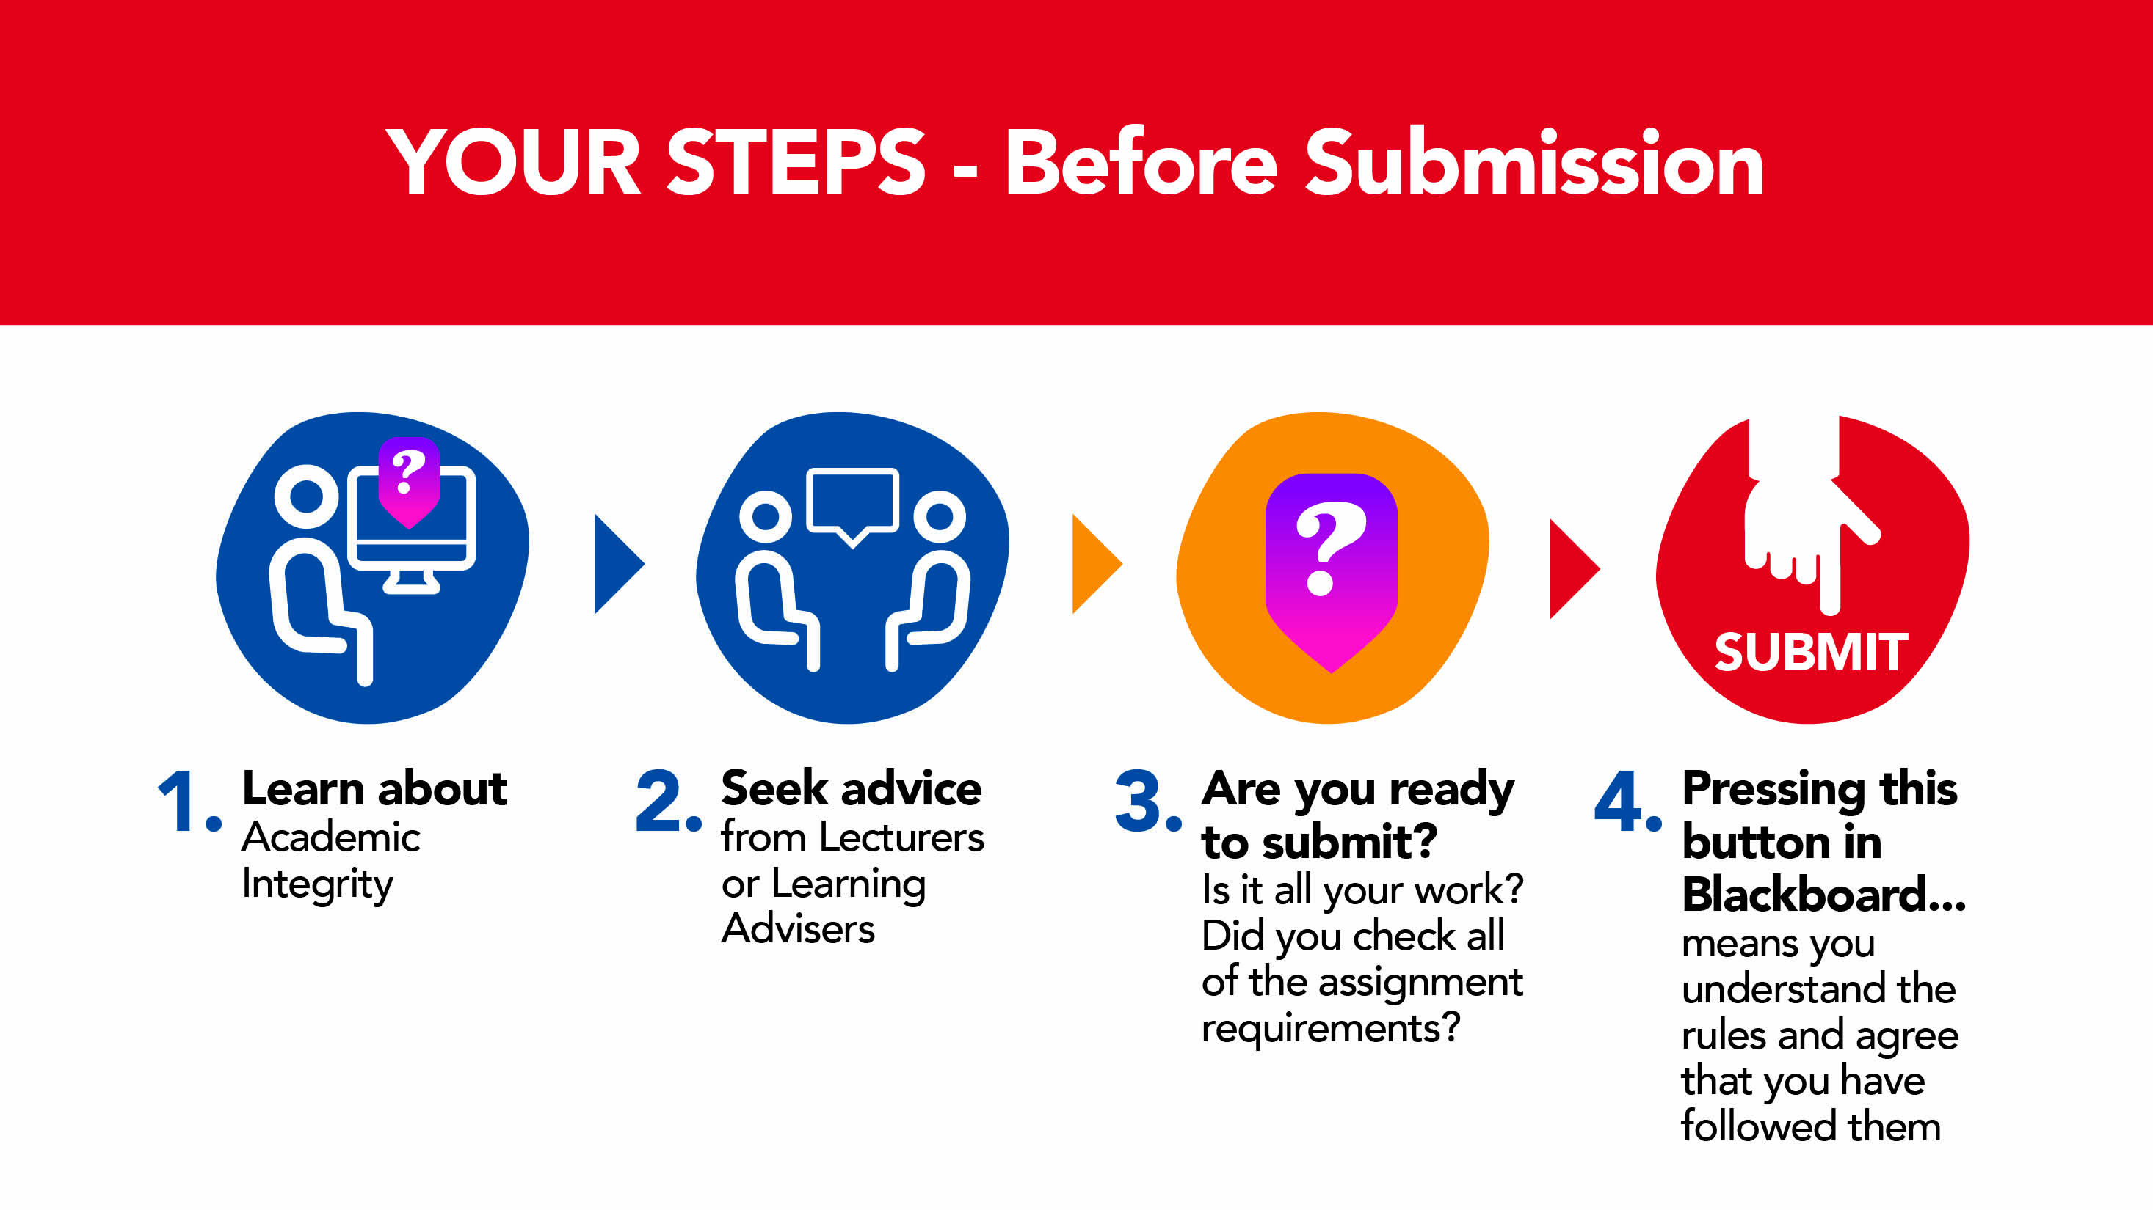
Steps to Submitting your work
Notes:
We Assume Students Know the Rules: it is assumed that all students, regardless of where they are from, how long since they last studied, or if they are in their first semester at university, have read the ECU rules in relation to Academic Integrity and Academic Misconduct. Subsequently ‘I do not know what academic integrity is, is not considered a reasonable excuse for breaches of Academic Integrity.
We Assume You Have Checked It: when undertaking an Academic Misconduct investigation, we assume that not only do students know the rules, but that they have thoroughly checked their own work against those rules prior to submitting their work.
Better Late Than Never: sometimes it can take a bit longer to thoroughly check your assignment in order to avoid breaches of Academic Integrity. It is better to submit your assignment a bit late and receive some late penalties rather than rush to submit by the deadline and end up involved in an Academic Misconduct investigation.

Slide 18
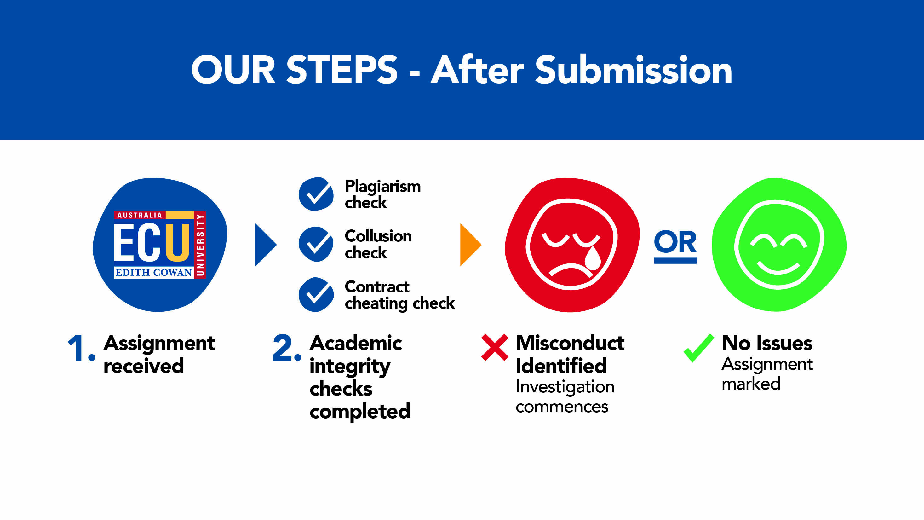
Steps Post-Submission

Slide 19

Conclusion
Academic Misconduct does not happen by accident. It typically occurs as a result of poor planning and/or choices made early in the assignment process.
During Academic Misconduct investigations, students will often rationalise why they felt it necessary to take the steps that led them to a misconduct investigation, and while the investigator may sympathise, such rationalisations have no impact on the final misconduct finding.
The best and only way to avoid the stress and marks impact of breaching Academic Integrity rules is simply not to do it in the first place.
Remember, check your work, ask your lecturer or tutor, speak to a learning adviser, but only before you submit your work, not after.

Slide 20
Resources (examples only insert relevant to your Unit)
Academic Skills Workshops
Attend an Academic Skills Workshop on a whole range of topics such as essay writing, report writing, referencing, etc. The schedule is available from the Academic Skills Centre Blackboard site under ‘My Communities’.
Assignment drop-in sessions
Attend a Assignment drop-in session <insert dates and time relevant to your unit> where you can get help with academic literacy and numeracy skills.
Subject guides
Please visit our, insert your specific discipline guides> subject library guides where you will find links to databases and other resources directly related to your subject, such as <insert her the relevant subject areas and more.
Referencing
For an introduction to APA Style (6th ed.) referencing and a selection of common sample references, check out the ECU Library Guide on Referencing https://ecu.au.libguides.com/referencing
AIM module
Complete the Academic Integrity Module – information and practical activities on how to develop your academic writing skills. [If you are not enrolled in this Module through your Unit contact academicintegrity@ecu.edu.au who will arrange to provide access to complete it.]
PASS
Peer Assisted Study Sessions are available for <insert if your unit is included in this program>. This program is where your peers assist you develop effective study skills.

Slide 21
References
Busch, P., & Bilgin, A. (2014). Student and staff understanding and reaction: Academic
integrity in an Australian university. Journal of Academic Ethics 12(3), 227-243.
doi:10.1007/s10805-014-9214-2
Edith Cowan University, Strategic and Governance Services. (2019a). Academic integrity policy. Retrieved from http://policysearch.ecu.edu.au/WebDrawer.PolicySearch/Record/725/file/document
Edith Cowan University. (2019b). Academic misconduct rules (students). Retrieved from http://policysearch.ecu.edu.au/WebDrawer.PolicySearch/Record/174/file/document
Fishman, T. (Ed.) (2014). The fundamental values of academic integrity. Retrieved from https://academicintegrity.org/wp-content/uploads/2017/12/Fundamental-Values- 2014.pdfttps://academicintegrity.org/wp-content/uploads/2017/12/Fundamental-Values-2014.pdf
University of Sussex. 2016. Academic integrity and avoiding plagiarism. Retrieved from http://www.sussex.ac.uk/skillshub/?id=287&site=normal
Adapted from a School of Science teaching resource with the kind permission of Justin Brown (ADTL, School of Science) and Tina Fleming (Senior Learning Adviser, School of Science), August 2019.

