Slide 1


What and Why all the fuss!
Notes:
The aim of these slides is to provide you some guidance/hints n tips when talking to New to ECU students about academic integrity in those first few weeks.
There is another set of slides that can be used in non-commencing units with ‘Experienced’ students as a student refresher on academic integrity or a reminder of good academic practice nearing an assessment task submission date.

Slide 2

What is academic integrity?
What do you understand by academic integrity?
Trust
Responsibility
Fairness
Honesty
Courage
Respect
(Fishman, 2014, p.14)
Notes:
Discussion Points:
Ask students to think about and discuss in pairs what they think academic integrity means
Academic Integrity and a students responsibilities – see https://intranet.ecu.edu.au/student/my-studies/academic-integrity/what-is-academic-integrity
Academic Integrity & Your Responsibilities
The International Centre for Academic Integrity defines academic integrity as "a commitment to five fundamental values: honesty, trust, fairness, respect, and responsibility", and “the courage to act on them even in the face of adversity" (Fishman, 2014, p.16). At ECU this is driven by our values of Integrity, Respect, Rational Inquiry and Personal Excellence.

Slide 3

Why is academic integrity important to YOU and ECU?
When starting at university you become part of, and contribute to, both the university and global academic community.
Acting with academic integrity means that:
Others can trust you.
They can rely on your honesty.
You will do what you say you will do.
You believe in doing the right thing.
Your future employability is heavily reliant
on your ability to demonstrate integrity and honesty.
It is a whole of university approach - Everyone has a role to play!
Trust
Honesty
(University of Sussex, 2016)
Notes:
Establishing expectations of good academic practice
Discussion – what do the students think it looks like?

Slide 4
What does academic integrity look like?
Fairness
Being engaged in your learning.
Undertaking your studies diligently and with the aim of genuinely achieving the learning outcomes of the Unit.
Being engaged in assessment tasks and submitting work that has been correctly in-text and end-text referenced.
Being honest about your own work - that the work you submit for Assessment is YOUR work, or if a group assessment task, the GROUP's work.
Considerate of the opinions and values of others, such as in group discussions or group assessment tasks.
Acting with integrity as part of your beliefs, who you are, and demonstrating the highest personal and professional standards
Respect
(Edith Cowan University, Strategic and Governance Services, 2019a)
Notes:
Acting with Academic Integrity – What does it look like?
Discussion – what do the students think it looks like?
Source: Academic Integrity Policy

Slide 5
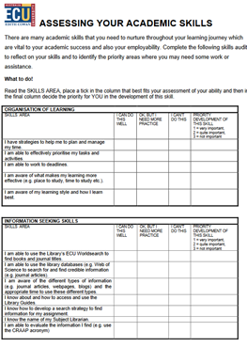
Acting with academic integrity
Courage
Be Organised
  Be aware of the hectic points in the semester.
  Plan for these – use a Semester Planner.
Know your Skills Set
  Do you read efficiently?
  Can you critically read and note-take?
  Do you know what is meant by referencing and how to do it?
  Can you paraphrase and summarise?
  Do you need to develop an academic voice?
Set yourself Manageable Timelines
  What workload requires a high level of planning?
  What workload requires low levels of planning?
  What is due soon?
  What is not due soon?
Keep track of your Research
  Where did you find the information you are referencing in the assessment task?
  Can you easily access it again if you need it?
Seek out Support
  Know what support there is and where to find it.
Source: student academic integrity website: https://intranet.ecu.edu.au/student/my-studies/academic-integrity/acting-with-academic-integrity
Notes:
See https://intranet.ecu.edu.au/student/my-studies/academic-integrity/acting-with-academic-integrity for more information
So what can you do to make sure you act with academic integrity and show good academic practice
Share the Quick Read – Five top tips to succeed in your first year of university:
Chisari, M. (2019, February 25). Five top tips to succeed in your first year of university. The Conversation. Retrieved from https://theconversation.com/five-top-tips-to-succeed-in-your-first-year-of-university-112135

Slide 6
So what is academic misconduct?
If a student uses other people’s work without due recognition of the author(s), works too closely together with other students on individual assessments or have other people complete their work for them (paid or unpaid) then this is academic misconduct.
Any conduct by a Student in relation to academic work that is dishonest or unfair, constitutes academic misconduct and includes:
a) Bribery or Coercion;
b) Cheating in Examinations;
c) Contract Cheating;
d) Fabrication and/or Falsification;
e) Failure to meet required research standards;
f) Plagiarism; and
g) Unauthorised Collaboration
as defined in the ECU University Rules: Academic Misconduct Rules (Students).
(Edith Cowan University, Strategic and Governance Services, 2019b)
Notes:
So what happens if you do not act with Academic Integrity
Academic Misconduct results in serious outcomes, including being asked to leave the university. Acts of academic misconduct DO NOT align to the Values of ECU, and are seen as unacceptable behaviours and may result in you being suspended or expelled.
Show them the ECU Academic Misconduct Rules (Students) document and where to find it: https://intranet.ecu.edu.au/student/my-studies/academic-integrity
Introduce them to the resources available on the student academic integrity website

Slide 7

Be AWARE!
It can sometimes be accidental but it can also be deliberate. Whether it’s intentional or unintentional it’s still misconduct, will be investigated and can lead to significant consequences.
Responsibility
It’s your responsibility to be aware of the requirements of proper academic conduct and to demonstrate good academic practice and ethical scholarship.
Let’s look at the most common forms of
academic misconduct…….
Notes:
As the audience is ‘New to ECU’ students spend some time talking about unintentional and how it is their responsibility to upskill and become AWARE of the expectations.
Busch & Bilgin (2014, p. 240) define “unintentional plagiarism occurs when students fail to understand how to quote accurately and paraphrase effectively due to lack of exposure to established academic norms”
Reference:
Busch, P., & Bilgin, A. (2014). Student and staff understanding and reaction: Academic integrity in an Australian university. Journal of Academic Ethics 12(3), 227-243. doi:10.1007/s10805-014-9214-2

Slide 8

Plagiarism
Notes:
Explain what is meant by plagiarism:
Plagiarism happens when you do not reference or acknowledge another persons work or ideas that you have used in your assignment
How would you feel if you had worked for years on a research topic, published all you hard work and then a university student came along and implied it was their work, research or ideas!
Teach the spirit of referencing at this point not the technicalities

Slide 9
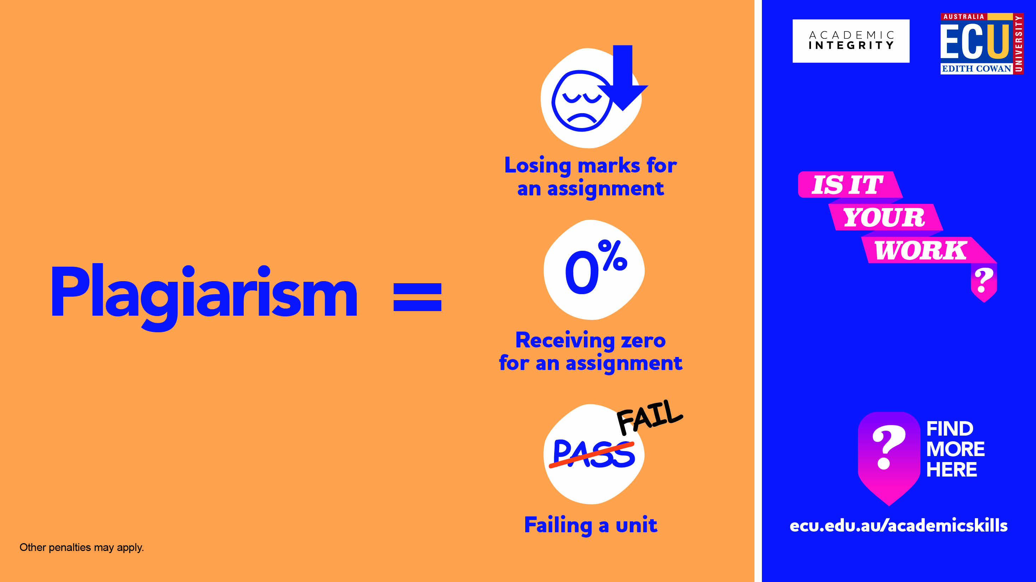
Plagiarism
Notes:
This is the consequences of plagiarising in your assessments

Slide 10
Avoiding Plagiarism
Do Not Copy and Paste: copying and pasting is the most common cause of students becoming involved in Academic Misconduct investigations. External sources should support your arguments and ideas.
Paraphrase/Summarise or Quote: write the idea/text in your own words and style (usually preferred) or you can “quote” them providing author, year and page number(s) from which the original text is taken..
Acknowledge Your Sources by Referencing: for each paraphrase or direct quote you must include an in-text reference with a corresponding end-text reference – the Reference List.
Check Your Work: run your assignment through Turnitin before you submit it, identify any required improvements. Make sure you leave enough time to do this before the submission date.
Do Not Re-Use Work: self-plagiarism is not allowed. If you wish to re-use your own work in another assignment or if you are repeating a unit, you can only do so if the unit coordinator gives you written permission prior to submission.
The Student Academic Integrity Website has more information on how to avoid Plagiarism: https://intranet.ecu.edu.au/student/my-studies/academic-integrity/avoiding-academic-misconduct
Notes:
Mention to the International students that this academic practice as it may be different from your home country. In many countries it is the norm to copy and paste – direct quote and disrespectful to paraphrase.

Slide 11
Referencing
Referencing is the academic practice of acknowledging other people’s work and ideas. These can be sourced in information sources such as books, journal articles, websites etc.
In-text referencing is within the body of your work and forms part of your academic writing.
End-text referencing is the corresponding reference that provides the full details of the in-text reference at the end of the assignment. They form the Reference List and allow the reader to access the full details of the information source.
At ECU the APA Referencing Style is the norm:
Check out the ECU Referencing Library Guide: https://ecu.au.libguides.com/referencing
For help on how to in-text reference as part of your academic writing
Check out the Academic Skills Centre workshops both on campus and online
https://intranet.ecu.edu.au/student/my-studies/study-assistance/academic-skills-centre
The Student Academic Integrity Website has more information on how to avoid Plagiarism: https://intranet.ecu.edu.au/student/my-studies/academic-integrity/avoiding-academic-misconduct
Notes:
Referencing is how you acknowledge another persons work, ideas or research that you have drawn on to support your ideas, arguments or discussion points
Just briefly go through the need to format in a certain way and introduce students to the Library Referencing Guide which has examples of how to do this for most types of information.

Slide 12
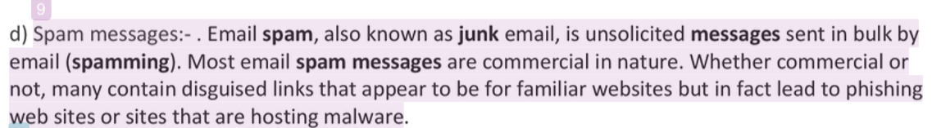
Turnitin
The following is an extract from a student assignment that lead to an Academic Misconduct investigation and eventually zero marks as 75% of the assignment was copied and pasted in a similar way. The main issues here include:
No author, year or page number (or paragraph number)
No “ “ quotes around the text to indicate it has been taken word for word from the original source
A low quality, non-academic source
Turnitin highlight inside student assignment
Turnitin similarity score reported at end of assignment document
The Student Academic Integrity Website has more information on how to avoid Plagiarism: https://intranet.ecu.edu.au/student/my-studies/academic-integrity/avoiding-academic-misconduct
Notes:
Take this opportunity to talk to students about Turnitin – what it is, what it does and how students can use its features to help them avoid plagiarism.
Show them where they will submit their first assessment and how it is submitted through a text matching software called Turnitin
Clarify that it is not a plagiarism checker but a text matching software – matching text that has been published previously elsewhere
Refer them to the 10 minute video about Turnitin and how to read a Turnitin Report (homework?). Can be sourced from the Student Academic Integrity Website:
https://ecu-panopto.aarnet.edu.au/Panopto/Pages/Viewer.aspx?id=88d4ede4-a8db-48eb-a893-aaa90078505e
More support resources about Turnitin are in the SLIDE Library Guide: https://ecu.au.libguides.com/slide/m3-6

Slide 13
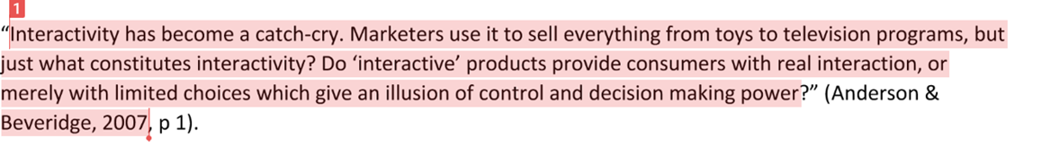
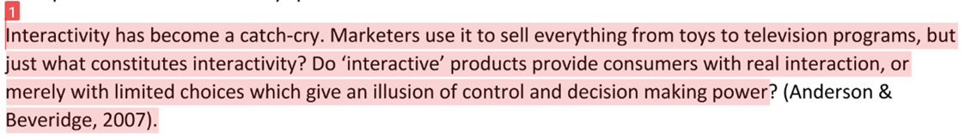
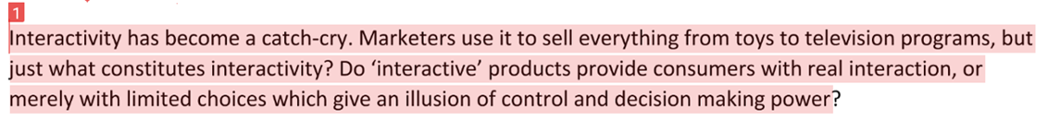
What about these examples?
Example 1:
Example 2:
Example 3:
The Student Academic Integrity Website has more information on how to avoid Plagiarism: https://intranet.ecu.edu.au/student/my-studies/academic-integrity/avoiding-academic-misconduct
Notes:
Suggest giving each table one example and ask them to identify if properly cited and if plagiarised or paraphrased.
Example 1: Properly cited as a direct quote and is the original that the examples are based on.
Example 2: cited but incorrectly quoted
Example 3: plagiarised

Slide 14
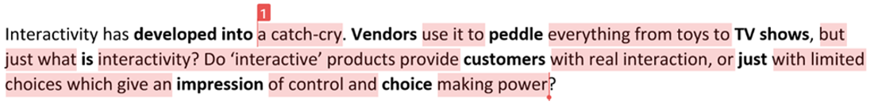
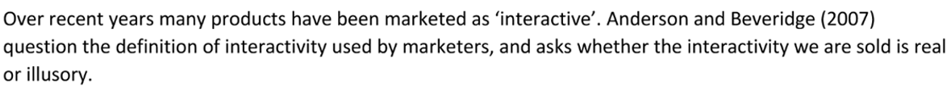
What about these examples?
Example 4:
Example 5:
Example 6:
The Student Academic Integrity Website has more information on how to avoid Plagiarism: https://intranet.ecu.edu.au/student/my-studies/academic-integrity/avoiding-academic-misconduct
Notes:
Example 4: plagiarised – no citation or quotation.
Example 5: plagiarised as not citation with word substitution- use of synonyms (partial attempt to paraphrase)
Example 6: correctly paraphrased and cited. NOTE: no text matching by Turnitin

Slide 15
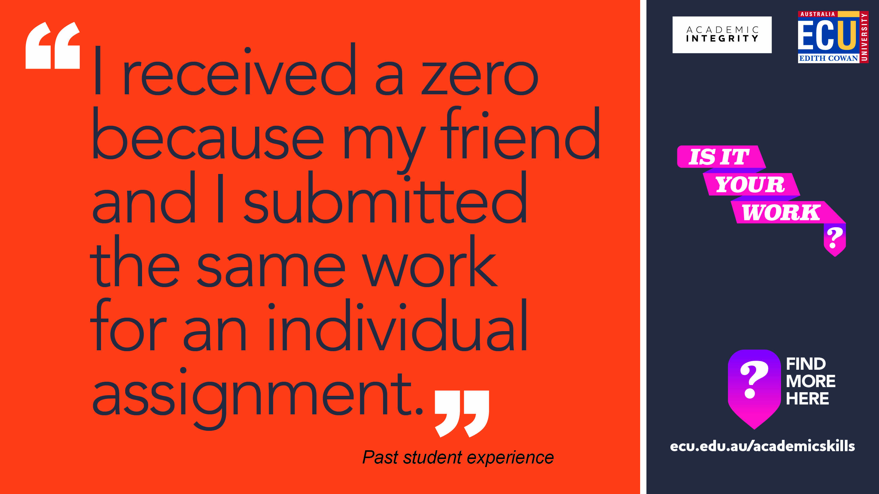
Unauthorised Collaboration
Notes:
What is Unauthorised Collusion?
Unauthorised Collaboration at ECU can also be termed as Collusion. It occurs when you submit work in an assessment task that was completed with someone else, when an individual response to the assessment task was required. This can include cross-group collusion.
International students be AWARE of this academic practice as it may be different from your home country. [in many countries working together is the norm and considered a good thing]
To avoid this form of academic misconduct be clear on the requirements of each assessment task. You can find this information in the Assessment Task instructions which will be documented in either the Unit Plan or Unit Blackboard Site. If in doubt always seek advise or clarity from your Tutor or Unit Coordinator.

Slide 16
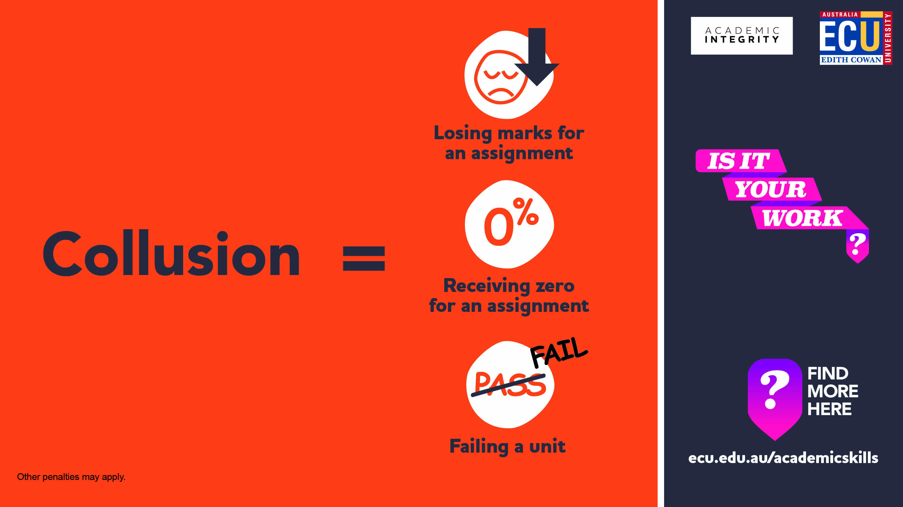
Unauthorised Collaboration
Notes:
The consequences of working collaboratively when an individual assignment is required.

Slide 17
Avoiding Unauthorised Collaboration
Do Not Share Your Work: it is ok for students to problem solve or offer each other advice, but never share your work with other students. Approximately half of collusion cases arise from one student giving their assignment work to a peer as a ‘guide’ to approaching the assignment, after which the recipient immediately submits the assignment as their own. This results in both students in an Academic Misconduct investigation.
Do Not Work Side by Side: sometimes two or more students will work as an unofficial team on an assignment problem which leads to these students submitting work that is very similar or identical. This results in these students being part of an Academic Misconduct investigation.
Note: Meeting with peers to discuss aspects of your learning, sharing ideas or even relevant articles for your assessment is part of your learning and being immersed in an academic community. It is not collusion if you then build from these discussions your own thoughts, ideas or arguments, and are trusted by your peers to present YOUR work for assessment. Remember your responsibilities as part of ECU and the wider global academic community. Also remember that your lecturers will rarely, if ever, set an assignment where they expect to see identical work submitted as part of an individual assessment.
If you are an International students be AWARE of this academic practice as it may be different from your home country.

Slide 18
Some scenarios to discuss
Scenario One:
A student is struggling with an assignment and contacts the Academic Skills Centre to seek the help of a Learning Adviser. They explain how to improve the draft assignment or better meet the assignment requirements.
Scenario Two:
Five students are working on their group assignment. They divide the assignment into five equal parts and each complete one. One student collates the work and submits it on behalf of the group
Scenario Three:
Three students e-mail their assignment drafts to one another. They all then revise their own drafts to include ideas they hadn’t previously considered, taking care not to copy each other’s ideas word for word.
Notes:
Scenario One – additional question: What happens if the student asked a parent instead? Or perhaps another student in the course?
Scenario Two – additional question: Is this collaboration? What if the task instructions required all students to contribute to each part?
Scenario Three – additional question: Would it be different is some ideas had been copied word for word?
For more scenarios see the Collaborating with Integrity Tipsheet: https://cheatingandassessment.edu.au/wp-content/uploads/2018/09/STUDENT-RESOURCE-Collaborating-with-integrity.pdf

Slide 19
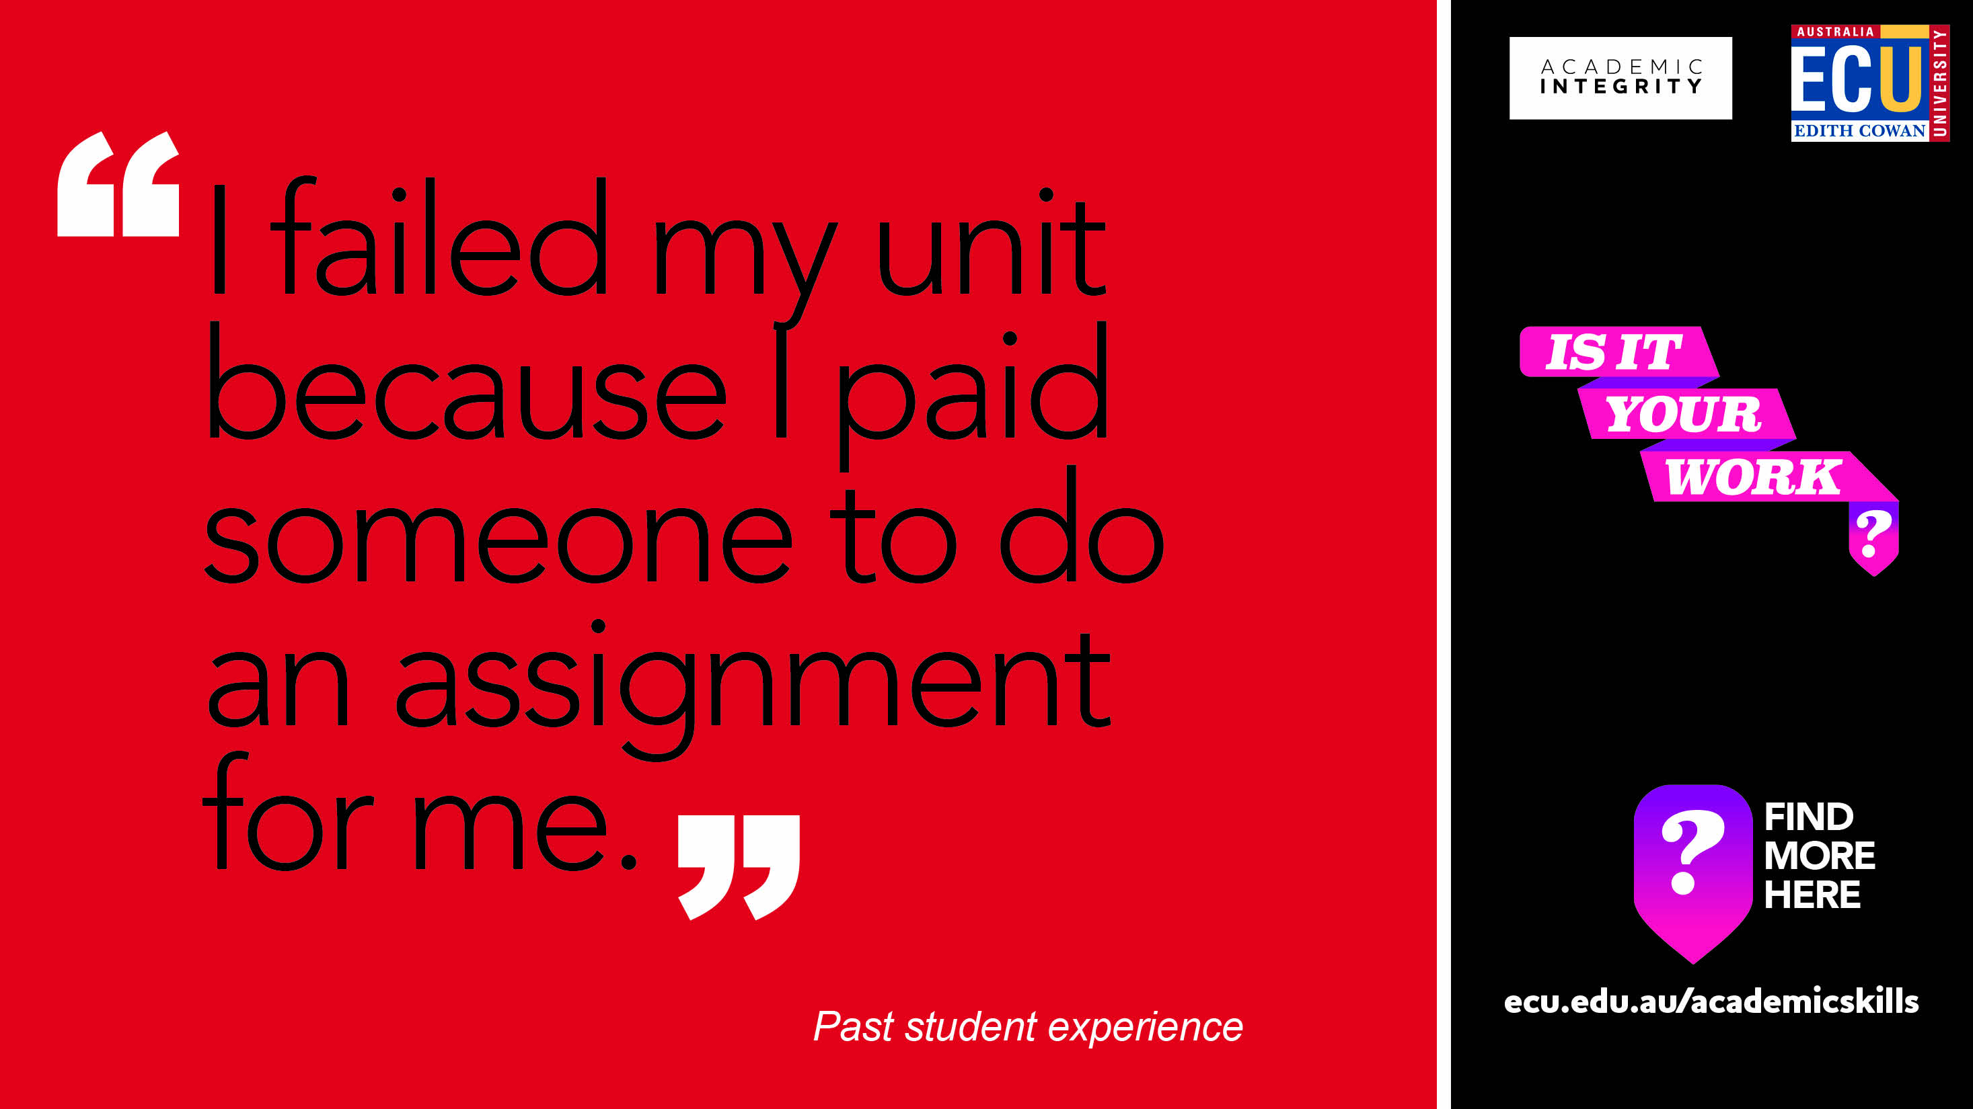
Contract Cheating
Notes:
Contract Cheating is when an assignment is outsourced to a third party. This can be paid or unpaid and is the most serious form of academic misconduct.
Does not align to ECU’s values of Integrity, Personal Excellence, Rational Inquiry and Respect
Evidence suggests that most cases of contract cheating could can be avoided if the student had demonstrated good academic practices or had sought out support from within the University at a time of need.
Take care as uploading your assignment to one of these essay mill site is also considered to be academic misconduct.

Slide 20
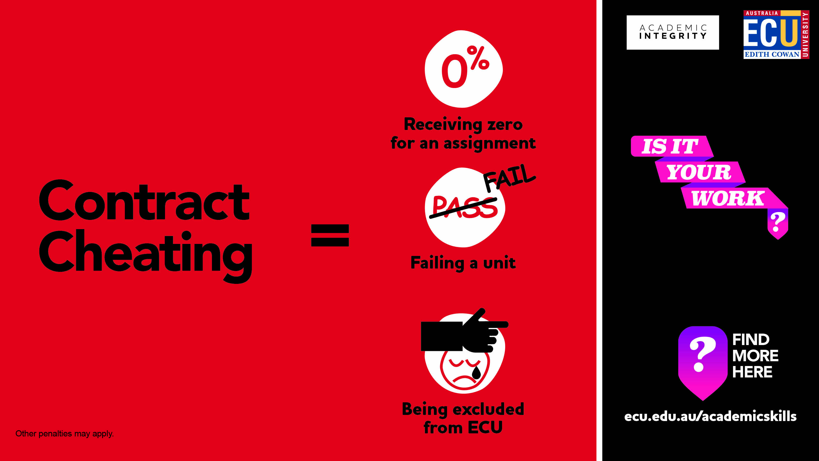
Contract Cheating
Notes:
Students who outsource their assignments will be caught as while technology can help them get someone else to do their assignment , technology also helps me (tutor) identify them.
These unscrupulous essay mills have also been know to blackmail students who have used their services (extortion etc.) – if you do find yourself in this position then please ask for help.

Slide 21


Avoiding Contract Cheating
Do Not Seek External Assistance: your lecturers and tutors are paid to assist and advise, but they do not provide answers. If you seek assistance from friends, prior students or external ‘tutors’ and they provide you with content or do some or all of the work for you then this is considered very serious Academic Misconduct. Actual contract cheating is quite easy to spot by our academic staff and is easily proven during subsequent Academic Misconduct investigations.
A Slippery Slope: contract cheating can start quite innocently by using paid ‘tutoring’ services, but in the end, if the ‘help’ you receive means you still cannot do the assessment work yourself (write it, code it, calculate it, analyse it) and you submit that work, it is contract cheating. Remember, these tutoring services could not care less if you are expelled from university as they have already been paid.
Remember the Learning Advisers are also there to help and support you.
https://intranet.ecu.edu.au/student/my-studies/academic-integrity/acting-with-academic-integrity
Notes:
So you need to be organised and if you need help then ask!
Show students where to go for help – these are all listed in the Student Academic Integrity Website in the ‘Seek out Support’ tab in the ‘Acting with Academic Integrity sub-page: https://intranet.ecu.edu.au/student/my-studies/academic-integrity/acting-with-academic-integrity

Slide 22
Let’s look a these scenarios
Scenario One:
Eight students gather in the Library to complete an online quiz together which is worth 10% of their grade. They share all their answers and only get one wrong.
Scenario Two:
A student shares their assignment from a previous semester with a friend now enrolled in the same course. The student is sure that her friend will not plagiarise it, but only use it as a guide.
Scenario Three:
A student is working on a large assignment and pays a professional assignment writer to complete parts of it for him. He knows that businesses regularly outsource work, so as long as he pays a fair price, he believes the work belongs to him and he can submit it as his own.
Notes:
Scenario One – additional question: Would it be different if the quiz was worth more? Do you think we (the tutors) expect you (students) to do these tasks together?
Scenario Two – additional question: What if her friend does plagiarise it, or submits it as her own? What if the student uploaded it to a file -sharing site so lots of students could use it?
Scenario Three – additional question: Does the work belong to him? Would it be worse if he had outsourced the whole assignment? What if he hadn’t paid money for it?
For more scenarios see the Collaborating with Integrity Tipsheet: https://cheatingandassessment.edu.au/wp-content/uploads/2018/09/STUDENT-RESOURCE-Collaborating-with-integrity.pdf

Slide 23
Unit specifics can be added here
When you add a new slide to this PowerPoint, you can choose from a number of layouts that have been set up within the Slide Master.
To do this, follow these steps:
  Select the “Home” tab at the top of your screen.
  Select the drop-down arrow next to “New Slide” (near top left corner) – here you can preview and select a template layout to suit your needs.
  Note: you can also change the layout of an existing slide by navigating to the desired slide, selecting “Layout” (near top left corner) and choosing a different layout.
When creating PowerPoints, only the ECU corporate colours should be used. These have been setup within the template (e.g.. you will see them when you go to change the font colour).
Note: there should be no need for you to edit the Slide Master however if you do, please keep in mind that any changes you make to master slides will affect all slides within your PowerPoint that use that particular layout.

Slide 24

The FINAL Checks

Slide 25
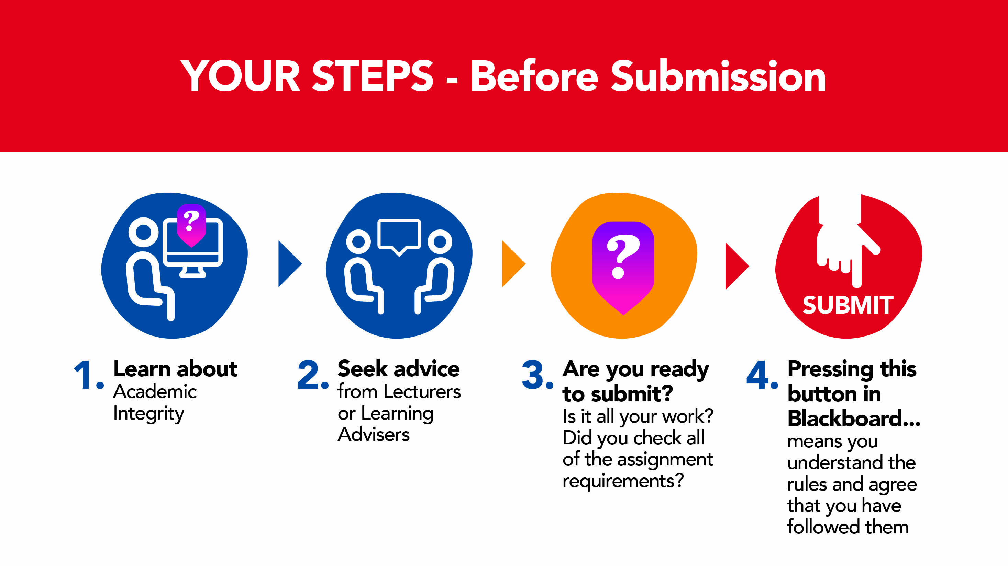
Steps to Submitting your work

Slide 26
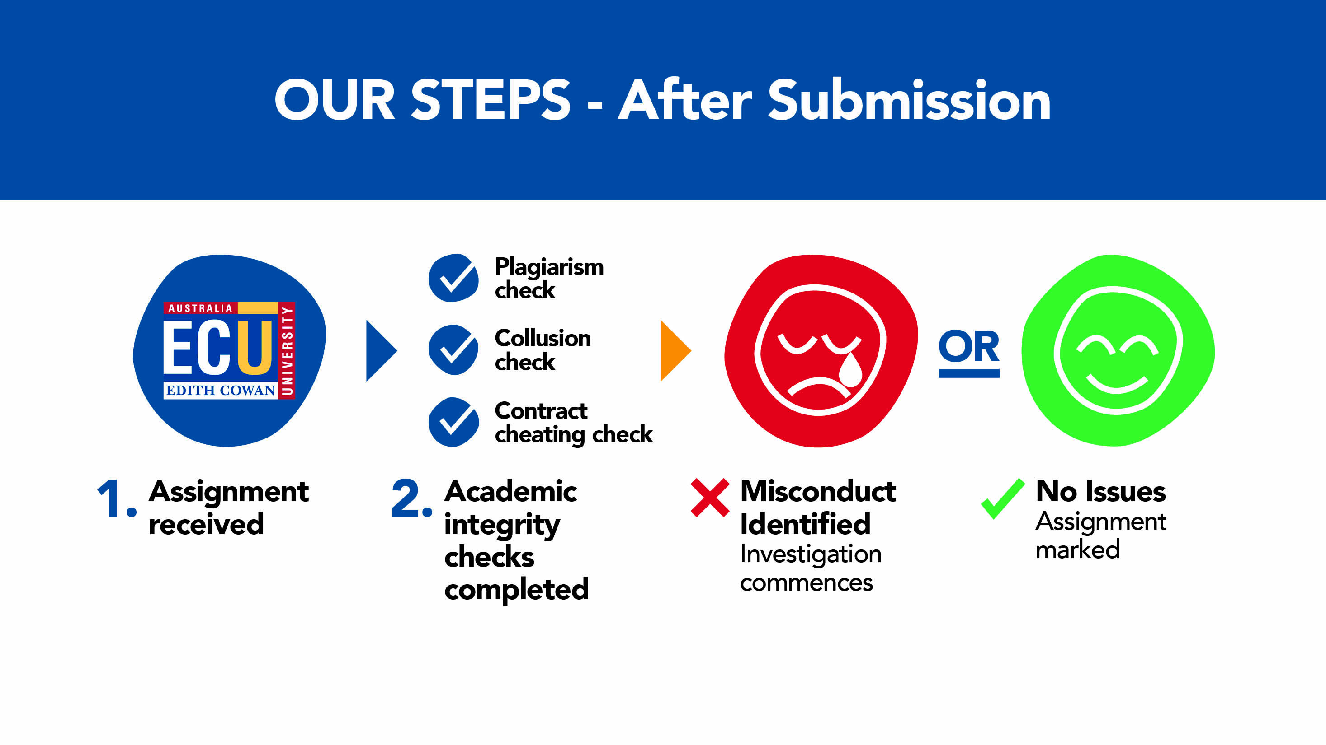
Steps Post-Submission

Slide 27

Why is Checking SO important?
We Assume Students Know the Rules: it is assumed that all students, regardless of where they are from, how long since they last studied, or if they are in their first semester at university, have read the ECU rules in relation to Academic Integrity and Academic Misconduct. Subsequently ‘I do not know what academic integrity is, is not considered a reasonable excuse for breaches of Academic Integrity.
We Assume You Have Checked It: when undertaking an Academic Misconduct investigation, we assume that not only do students know the rules, but that they have thoroughly checked their own work against those rules prior to submitting their work.
Better Late Than Never: sometimes it can take a bit longer to thoroughly check your assignment in order to avoid breaches of Academic Integrity. It is better to submit your assignment a bit late and receive some late penalties rather than rush to submit by the deadline and end up involved in an Academic Misconduct investigation.

Slide 28

Conclusion
Academic Misconduct does not happen by accident. It typically occurs as a result of poor planning and/or choices made early in the assignment process.
During Academic Misconduct investigations, students will often rationalise why they felt it necessary to take the steps that led them to a misconduct investigation, and while the investigator may sympathise, such rationalisations have no impact on the final misconduct finding.
The best and only way to avoid the stress and marks impact of breaching Academic Integrity rules is simply not to do it in the first place.
Remember, check your work, ask your lecturer or tutor, speak to a learning adviser, but only before you submit your work, not after.

Slide 29
Resources (examples only insert relevant to your Unit)
Academic Skills Workshops
Attend an Academic Skills Workshop on a whole range of topics such as essay writing, report writing, referencing, etc. The schedule is available from the Academic Skills Centre Blackboard site under ‘My Communities’.
Assignment drop-in sessions
Attend a Assignment drop-in session <insert dates and time relevant to your unit> where you can get help with academic literacy and numeracy skills.
Subject guides
Please visit our, insert your specific discipline guides> subject library guides where you will find links to databases and other resources directly related to your subject, such as <insert her the relevant subject areas and more.
Referencing
For an introduction to APA Style (6th ed.) referencing and a selection of common sample references, check out the ECU Library Guide on Referencing https://ecu.au.libguides.com/referencing
AIM module
Complete the Academic Integrity Module – information and practical activities on how to develop your academic writing skills. [If you are not enrolled in this Module through your Unit contact academicintegrity@ecu.edu.au who will arrange to provide access to complete it.]
PASS
Peer Assisted Study Sessions are available for <insert if your unit is included in this program>. This program is where your peers assist you develop effective study skills.

Slide 30
References
Busch, P., & Bilgin, A. (2014). Student and staff understanding and reaction: Academic
integrity in an Australian university. Journal of Academic Ethics 12(3), 227-243.
doi:10.1007/s10805-014-9214-2
Edith Cowan University, Strategic and Governance Services. (2019a). Academic integrity
policy. Retrieved from
http://policysearch.ecu.edu.au/WebDrawer.PolicySearch/Record/725/file/document
Edith Cowan University. (2019b). Academic misconduct rules (students). Retrieved from
http://policysearch.ecu.edu.au/WebDrawer.PolicySearch/Record/174/file/document
Fishman, T. (Ed.) (2014). The fundamental values of academic integrity. Retrieved from
https://academicintegrity.org/wp-content/uploads/2017/12/Fundamental-Values-
2014.pdfttps://academicintegrity.org/wp-content/uploads/2017/12/Fundamental-Values-2014.pdf
University of Sussex. 2016. Academic integrity and avoiding plagiarism. Retrieved from
http://www.sussex.ac.uk/skillshub/?id=287&site=normal
Adapted from a School of Science teaching resource with the kind permission of Justin Brown (ADTL, School of Science) and Tina Fleming (Senior Learning Adviser, School of Science), August 2019.

