Slide 1

Fire or Emergency Information
Fire or other Evacuation Emergencies
  If you hear the fire alarm (woop-woop tone), follow the instructions of your lecturer or fire warden and proceed to evacuate the building.
  Evacuate by nearest safe EXIT and move to Assembly Area (as highlighted on the maps in each space).
  If the alarm is not already raised, warn people in the immediate area and use RED break glass alarm (if available).
  If required call emergency services on 000.
  Do not re-enter the building until the “all-clear” has been given by the Building Warden.
  Medical Emergencies
  If you believe an ambulance is required, call 000 and then Security on 3333.
  Security staff are trained in First Aid, there are also First Aid Boxes and Defibrillators located throughout the campuses.
  Note: You should familiarise yourself with all emergency exits, red break glass alarms, first aid equipment and security phones in your area.

Slide 2
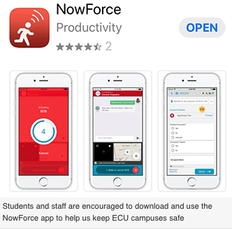
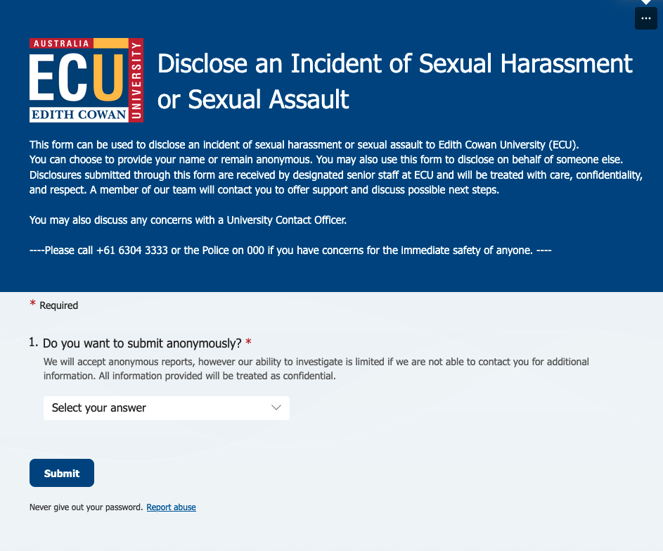
ECU Reporting Tools - what’s the difference

Slide 3
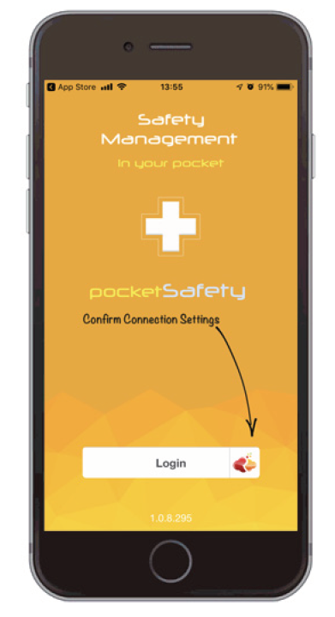

Health and Safety Reporting
  Hazards, incidents, injuries and near miss incidents (this is an incident that could have resulted in an injury) need to be reported to a University staff member as soon as possible.
  This includes off-campus incidents related to your study such as on fieldtrips, study tours and practicum placements.
  PocketSafety App
  You can also report health and safety incidents or hazards to ECU in real time using your smart phone or device.
  Download pocketSafety from the App Store or Google Play and type access code “ECU” in the connection settings before logging in.

Slide 4
Personal Security
  On-campus safety and security
  If you see suspicious or anti-social behaviour, witness or are involved in a security incident, please contact ECU Security immediately on 6304 3333 or use the many security phones located on each campus.
  ECU Security provide accompaniment services to walk with you around campus 24/7 every day of the year.
  If attending the campus out of hours we encourage the use of the Working Alone functionality within the Nowforce App, staying to the many well lit pathways and parking close to the building you are working in (parking zone restrictions do not apply after 5pm).
  If you even feel a just little unsafe at any time, call security on 6304 3333
  FOR LIFE THREATENING EMERGENCIES
  Always CALL 000 FIRST.

Slide 5
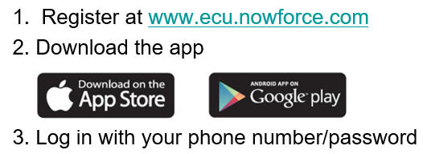
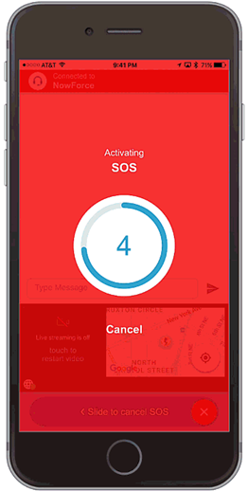
Nowforce App - Personal Security Response
ECU’s Nowforce app gives you the opportunity to contact Security staff directly from your mobile phone anytime day or night.
This includes a live mobile duress alarm link directly to our 24/7 control room. (This app sends us your GPS location, video, audio, name etc).
ECU Security will initiate a response both on and off-campus.
The working alone functionality is included, meaning security will check on areas where you study after hours, and provide peace of mind.

Slide 6
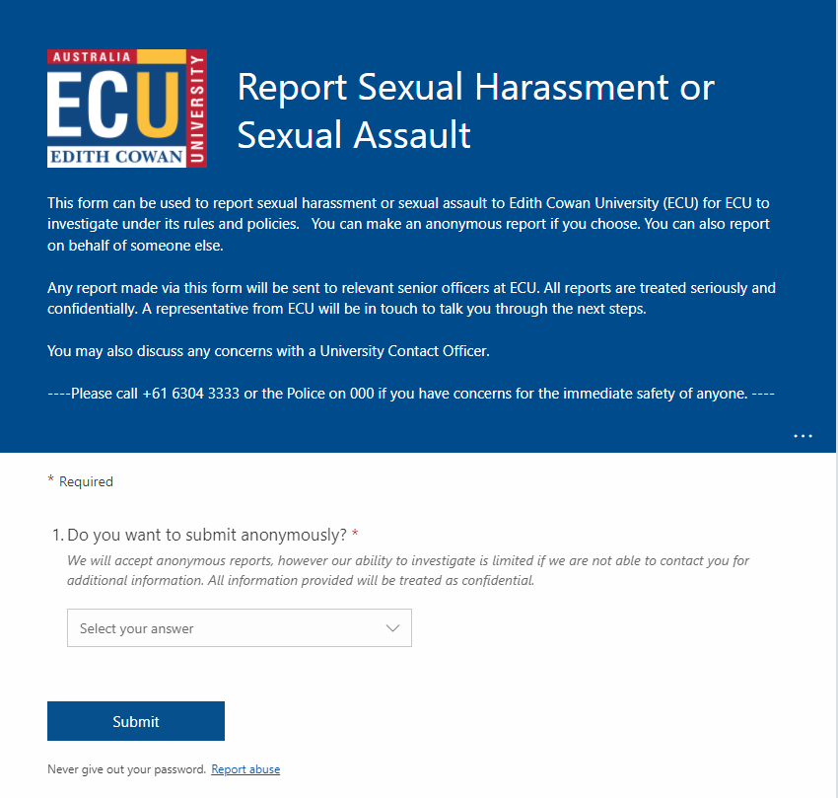
Sexual Harm
At ECU we are committed to a safe learning and working environment. We have zero tolerance for anyone experiencing sexual harm while engaging in University activities undertaken in the course of work, study, research, or socialising. Sexual harm may include sexual assault and sexual harassment incidents.
The University’s approach to dealing with incident of sexual harm is expressed within the Sexual Assault and Sexual Harassment Policy which is founded on the principle that responses to disclosures of sexual harm should occur with dignity, respect and empathy for all involved persons.
Support is available from ECU and other organisations, no matter when or where the sexual harm occurred. Please view our Student Portal Webpage for further information.
We recognise that reporting an incident of sexual harm is an individual decision which only the impacted person can make.
However, the University does encourage anyone who has experienced or witnessed an incident of sexual harm on our campuses, or at any of our activities, to report the incident to us. You may remain anonymous when reporting such incidents.
ECU Security: call (08) 6304 2282
Report via our online form.

Slide 7
Support and Other Information
Student Health Services
Appointments
Appointments with a doctor on campus can be made during opening hours of:
Monday to Friday - 8.30am and 4.30pm (AWST).
We are located on both metro campuses in the following locations:
Joondalup campus, Building 6, Room 6.230, Telephone: (61 8) 6304 5618
Mount Lawley campus, Building 8, Room 8.109, Telephone: (61 8) 6304 6814
If you require medical treatment in the South West there is no medical centre on campus, but there are medical centres in Bunbury and surrounds. Visit HOT DOC to find a medical centre in your area.
ECU Student Health Services is closed on weekends and public holidays.
Psychological Counselling Support
This free service is available on all three campuses. Call 9370 6706 for an appointment.
Access and Inclusion
Provides support to students with diverse study needs. Ph: 9370 6960 or studentequity@ecu.edu.au
Out of hours crisis line for ECU students
Call 1300 583 032 or text 0488 884 232.
This phone support service operates from 4.30pm to 9.00am on weekdays, and 24 hours on weekends, providing students with mental health and well-being support. The service is intended to help callers find immediate relief from emotional distress, explore coping strategies for the current crisis.

